Slide 1
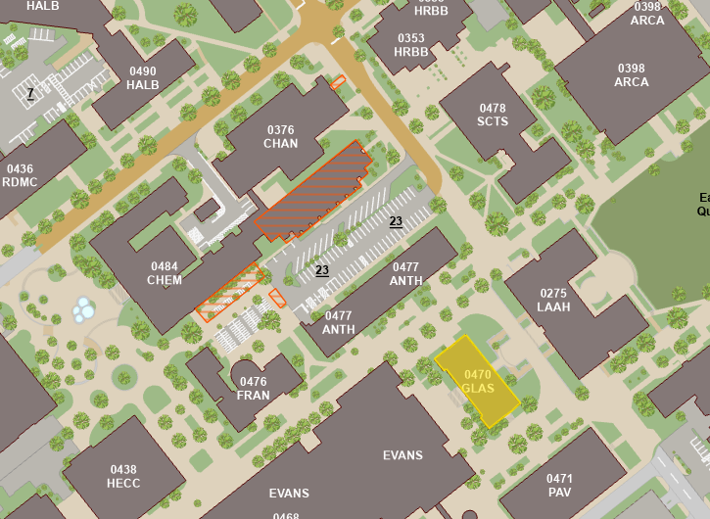
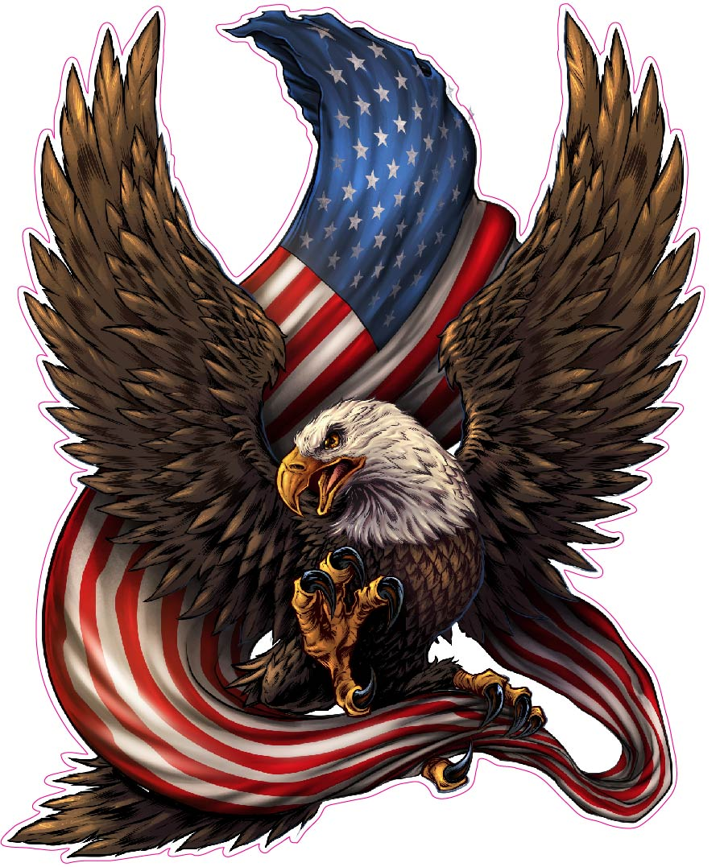
Course Info
Time: MW 4:10-5:25 PM
Location: Chem 100
Instructor: Dr. Lorien Foote
Office: GLASS 211A
Email: lfoote@tamu.edu
Office Hours
MW 10:20-11:20 AM
MW 1:30-2:30 PM
By appointment
Teaching Assistant: John Lewis
Office: GLASS 003B
Email: john-lewis@tamu.edu
Office Hours
TR 10:00-11:00 AM
Grading:
Assignment | Due Date | Max Points
Martin Essay Quiz | Sep. 4 | 25
Sledge Essay Quiz | Oct 30 | 25
Military Image | Nov 20 | 25
Sherman Quiz | Sep 25 | 25
Cordon of Steel MC Quiz | Nov 11 | 10
Soldier Comparison Essay | Dec 6 | 40
Midterm | Oct 9 | 100
Final | Dec 6 (3:30-5:30) | 100

Slide 2
Topics Covered:
Aug 19: Indian Warfare and Adaptation
Aug 21: Colonial Wars
Aug 26: American Revolution
Aug 28: American Revolution
Sep 4: Early Republic
Sep 9: War of 1812
Sep 11: National Expansion
Sep 16: The Mexican War
Sep 18: The Civil War
Sep 23: The Civil War
Sep 25: The Civil War
Sep 30: Reconstruction and Frontier Wars
Oct 2: War for Empire
Oct 9: Midterm
Oct 14: Early 20th Century
Oct 16: The Great War
Oct 21: Inter-War Years
Oct 23: World War II
Oct 28: World War II
Oct 30: World War II
Nov 4: Atomic and Cold War
Nov 6: Korean War
Nov 11: Vietnam
Nov 13: Vietnam
Nov 18: Vietnam
Nov 20: Recovery and End of Cold War
Nov 25: Gulf War
Dec 2: War on Terror

Slide 3
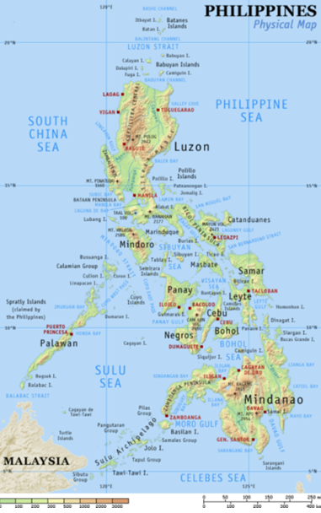
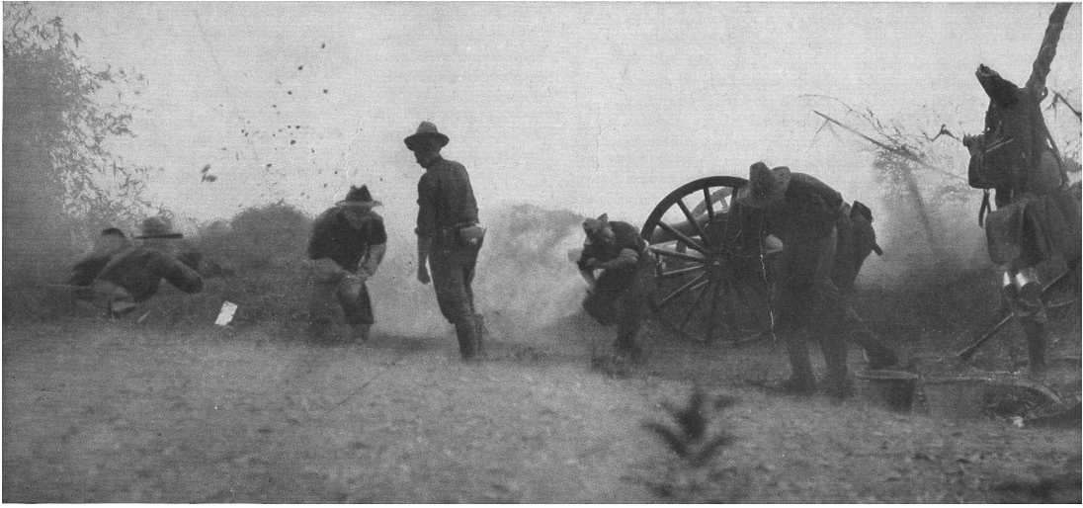
Preserving the Empire
Conflicts protecting colonies and conflicts with neighbors
US-Philippine war (1898-1902)
War of occupation leads to a war of conquest
Leader of the Philippine resistance was Emilio Aguinaldo
The Philippines declared independence when the war started
Besieges Manila
Major general Wesley Merritt put in charge of American forces
He was a cavalry officer during the civil war and fought in Apache wars
Initially, he was ordered to not get entangled with the Filipino independence movement
McKinley didn’t know if he wanted to take the islands as a colony yet
The Spanish general put in charge offered a pretend battle to the Americans, so he didn’t lose the Spanish honor.
Spanish retreat after putting up a fight, and at this point, McKinley decided to take the Philippines
Real battle of Manila (1989)
1000 Americans lead an offensive against 20,000 poorly trained Filipino troops
Largest battle for the USA between the civil war and WW1
Offensive peters out after a little bit

Slide 4
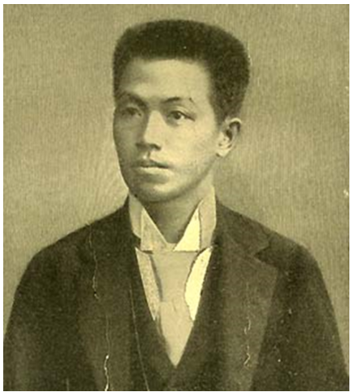
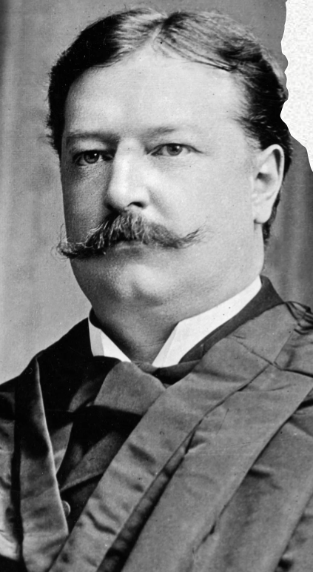
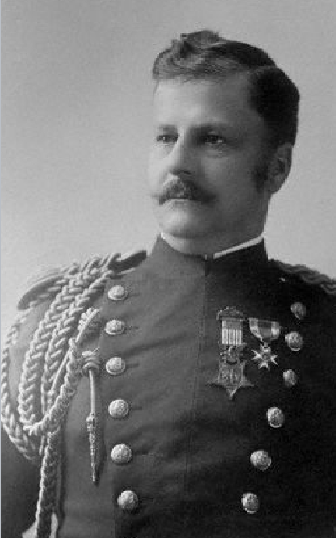
Filipino change in tactics to a guerrilla war
Forces were spread out between multiple armies
This meant that the defeat of one army wouldn’t have much of an effect on all of them, but no offensives could be planned
Ambush tactics were used: pits with spikes were covered with bamboo leaves for unsuspecting soldiers
Underground governments were instated in cities of American control to harass people who supported the Americans
Planned an offensive during the election season to attempt to get an anti-imperialist in office
Didn’t work, Teddy still won
US Response
Taft Commission: Transition to civil government from occupation
Build roads, bridges, schools and give medical support to the population
Send in Arthur MacArthur
Arthur was a volunteer in the civil war (Wisconsin) and won the medal of honor at the battle of Chattanooga when he led a charge while carrying the American flag
Douglas MacArthur’s Dad
Has 70,000 troops (70%) of the army
He captures Aguinaldo when he intercepts a messenger and sends a disguised force to force him to surrender
Has garrisons work with the people instead of patrolling them
Pacifies Sumar (most resistant island) by slaughtering all livestock, burning fields, and killing all men
Uses concentration camps to round up 300,000 people where he then sent 4,000 troops to kill all remaining people and destroy foodstuffs
In 1902, the last guerrilla commander surrenders

Slide 5
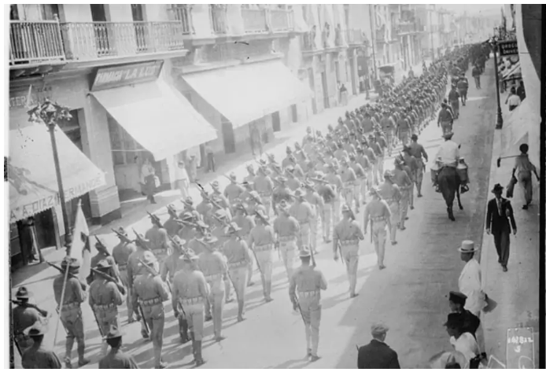
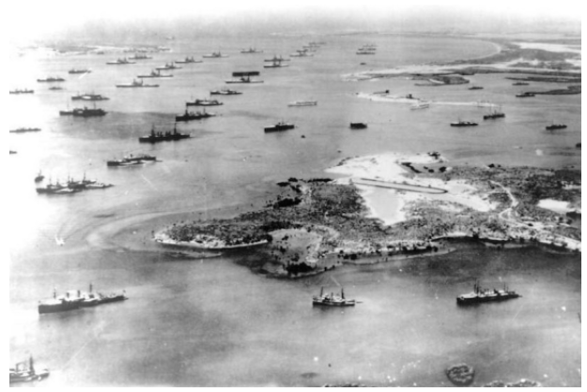
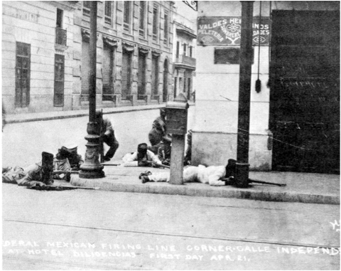
Interventions in Latin America
Goals throughout the campaigns: Stabilize region, prevent reestablishment of colonies
Mexico 1914
In 1913, Victoriano Huerta led a coup against the government, and civil war almost immediately erupted.
Germans were trying to send military aid through Veracruz, and America didn’t like that, so The Americans invaded the port with a force lead by Frank Fletcher
The initial troops that got there were bogged down in street fighting, but marines came in and used similar tactics to the ones used by Zachary Taylor in Monterrey

Slide 6
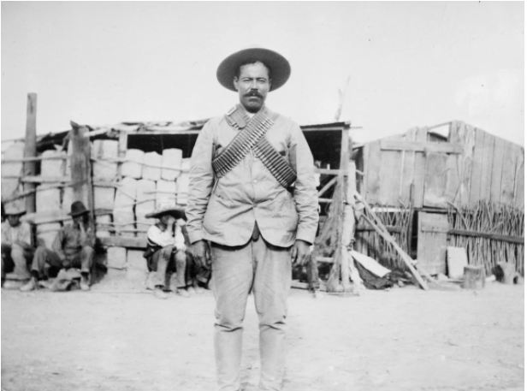
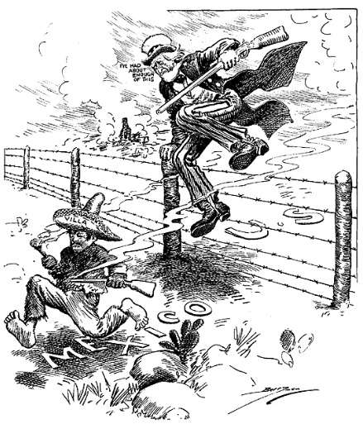
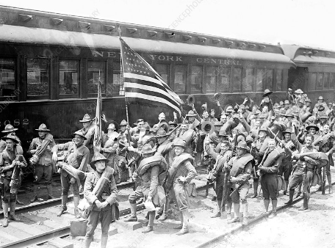
Mexico 1916
Pancho Villa wants support from the USA, but the Americans don’t give it to him.
So, he conducts raids into the US, killing 15
Wilson orders Punitive action against him, and sends in 10,000 troops led by Pershing
Mexico mobilizes to stop the US, and Wilson mobilizes the national guard
This is the first time the national guard was used without congress first declaring war
Both governments end up backing off once Wilson realizes he will have to go to war with Germany
Haiti 1915-1934
Since Haiti had gotten independence, there had been 102 civil wars and 22 of the past presidents hadn’t served their terms
Marines occupy the port towns and within 2 months, the country had been pacified

Slide 7
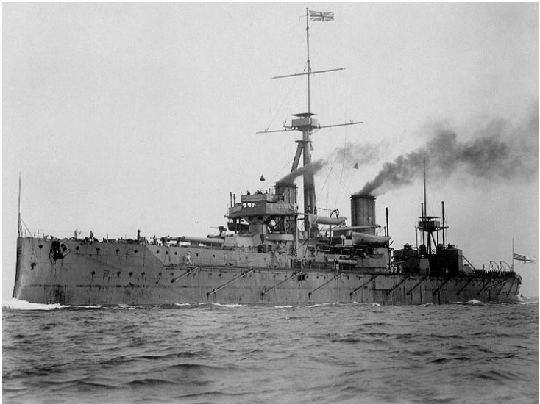
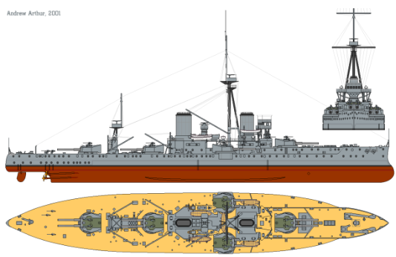
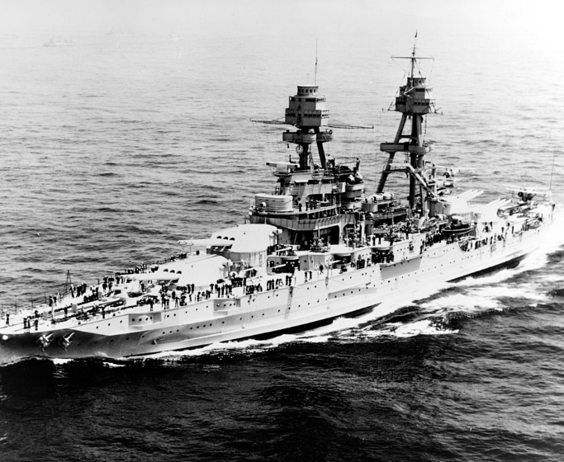
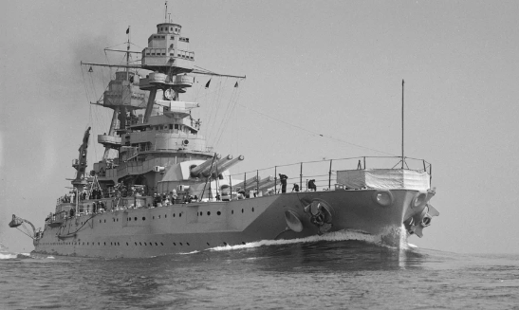
Modernizing the Navy
At the beginning of the century, the Great White Fleet was built with the best battleships in the world
However, they became instantly obsolete with the creation of the HMS Dreadnaught
10 12-inch guns on 5 turrets with a range of 25,000 yards
Started the naval arms race
The USS Pennsylvania was created as a response to the dreadnaught
Displaced 32,000 tons, 24 mph, 12 14-inch guns with 4 turrets, used oil
1916 Naval Act
Had the goal of being “second to none”
Built to serve across 2 oceans
5-year program to construct 156 modern vessels
40% increase in the size of the navy
The act made more naval bases in on the coast of the contiguous US rather than overseas where they were more needed
Due to congressmen wanting bases in their states

Slide 8
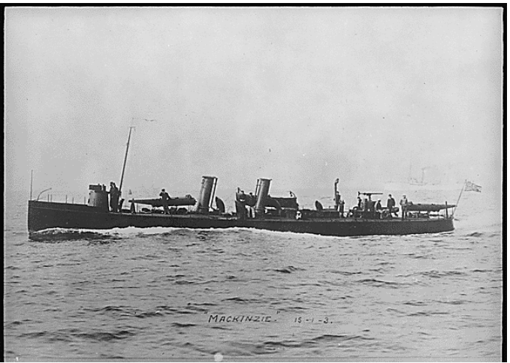
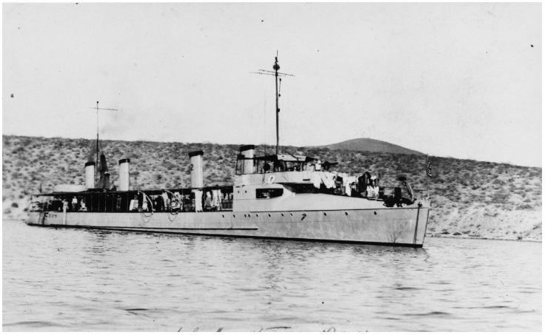
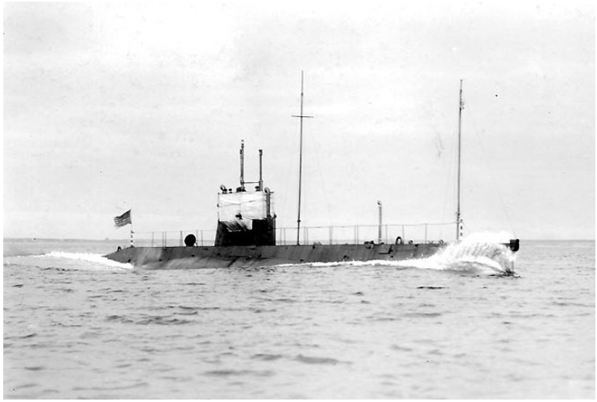
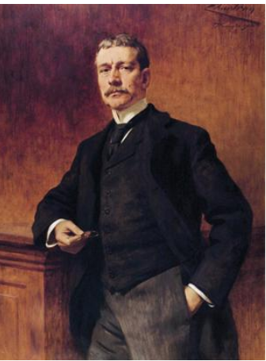
After the release of the dreadnaught, everyone was following Mahan’s doctrine of building a large fleet for a decisive battle, but asymmetric threats became more important
No one wanted to lose the dreadnaughts after all the money was put into them
Asymmetric threats:
Torpedo boats – carried compressed air torpedoes to fire at large ships
Torpedo boat destroyers – used on periphery of fleet to block torpedo boats
Submarines – didn’t have a set place in the navy, but many ideas
Scouting, commerce raiding, and attacking big boats were all ideas
Modernizing the army
Secretary of war Elihu Root had two ideas
Have best trained officer corps
Always fight with volunteers
Creation of a lot of schools to train officers
Learn strategy, operations, war games
Change in underlying belief of the civilian soldier to the institution to pass on techniques

Slide 9
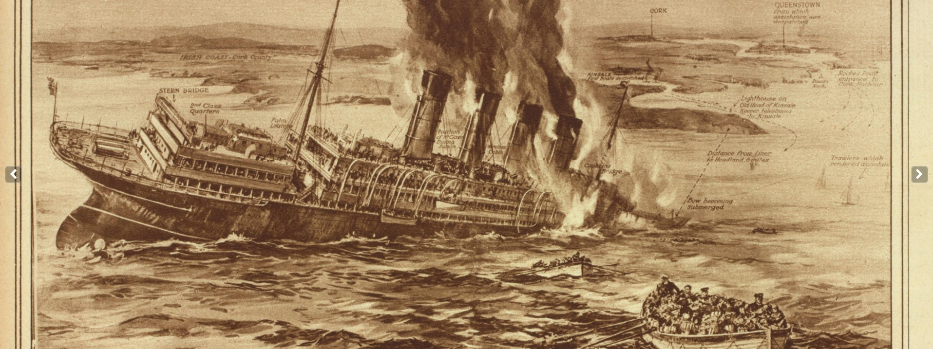
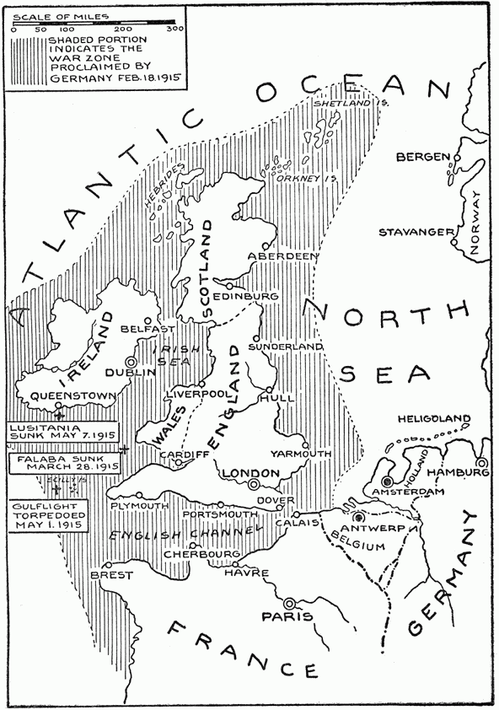
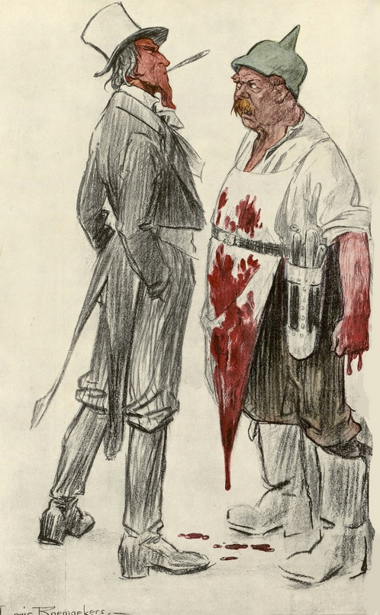
The Great War
Initially, The US was neutral
Americans didn’t know who to support
There were tons of German immigrants and tons of Irish immigrants who hated the British
German Unrestricted Submarine warfare
Unrestricted submarine warfare was a tactic used by submarines to destroy all merchant ships without giving them any warning
Germany destroyed all ships in the shaded area in the picture below
This tactic gradually brought America into the war, as the sinking of all ships went against America’s freedom of the seas.
When the Lusitania sank, America demanded all unrestricted submarine warfare stop.
Germany initially complied, but then concluded that Unrestricted submarine warfare was worth the risk.
They thought the US wouldn’t be able to field a large army until 1919
America declared war

Slide 10
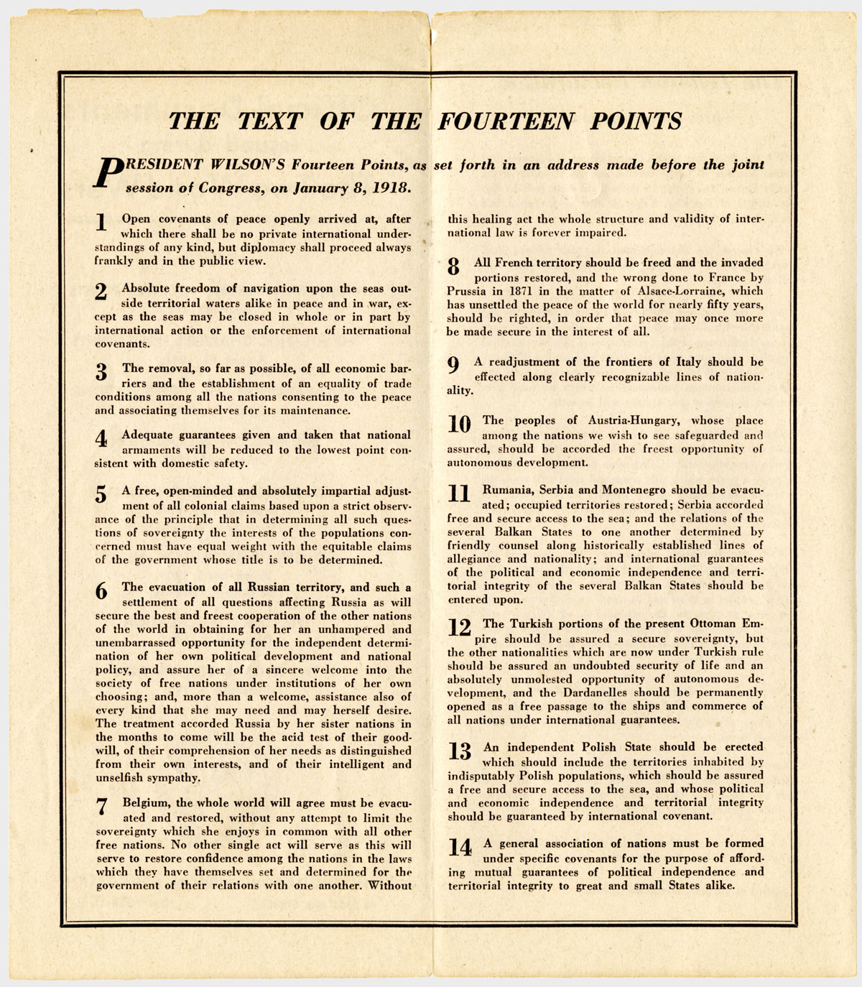
America’s goals of the war were outlined in Wilson’s 14 points
1-5 were focused on dismantling empires, 5-13 were focused on self determination, and 14 called for the creation of the league of nations
Article 2 and 5 were the most controversial among Europeans
2 called for freedom of the seas
5 called for colonies to be freed
To accomplish these war goals, a large ground force was needed to promote America’s diplomatic authority
They had a late start by 3 years, so getting their goals accomplished would be an uphill battle
For reference, the Germans had lost 1.2 million men by this point.
The largest army America fielded before this was 1 million in the civil war. The army at this point had 300,000 men

Slide 11
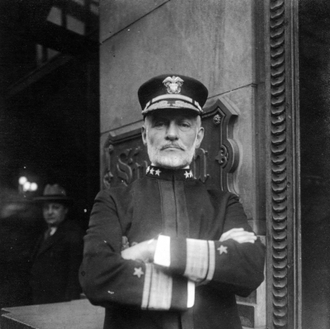
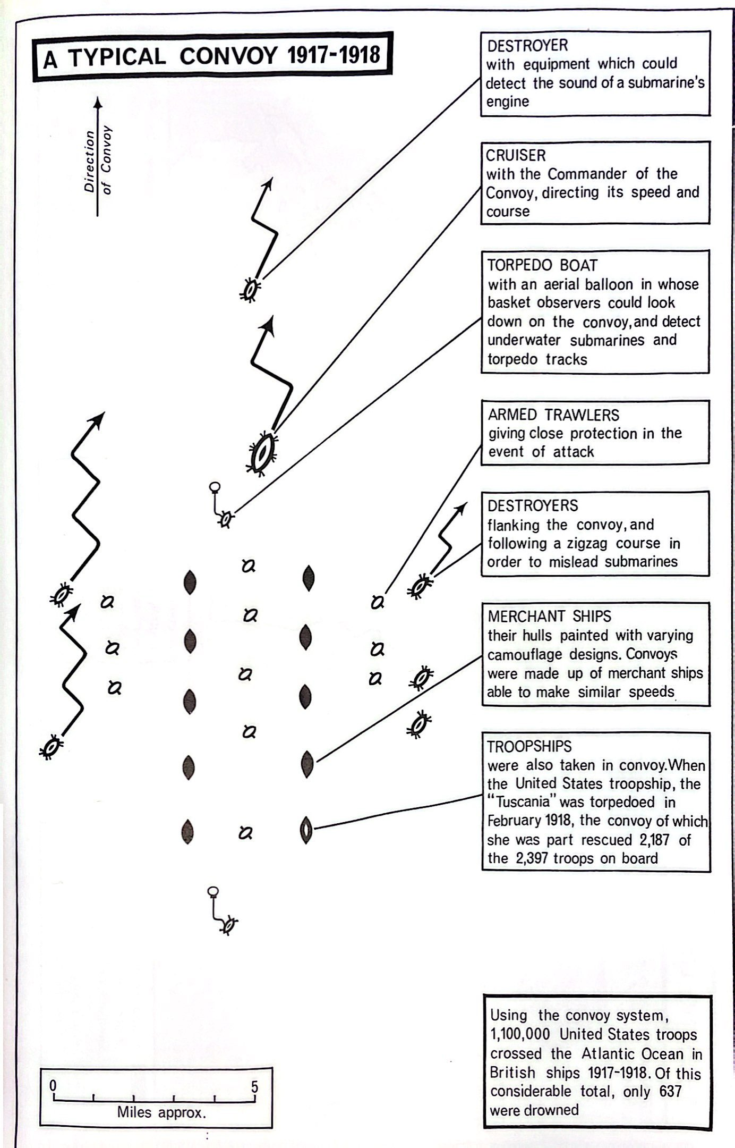
Naval combat
Mahan’s decisive battle theory every nation had played into did not hold true
The only large dreadnaught battle was the battle of Jutland, and it was completely indecisive, as the Germans just retreated to port and stayed there for the rest of the war
Admiral William Simms was sent to be in Britain before America entered the war
He was very persistent
Learned of the magnitude of British loses and knew the Germans were suffocating the British
The British told him they would have to surrender by late 1917 if the rate at which ships were being sunk continued
Kept insisting that the Americans send destroyers to Britain
Helped develop the convoy system, where merchant ships would be better guarded from submarines
Went up to the prime minister himself to make the case for the system
Observation balloons were used to detect incoming torpedoes, and destroyers were dispersed across all sides to hunt down submarines
This significantly decreased the loses of merchant ships the British sustained from 20% to 0.5%

Slide 12
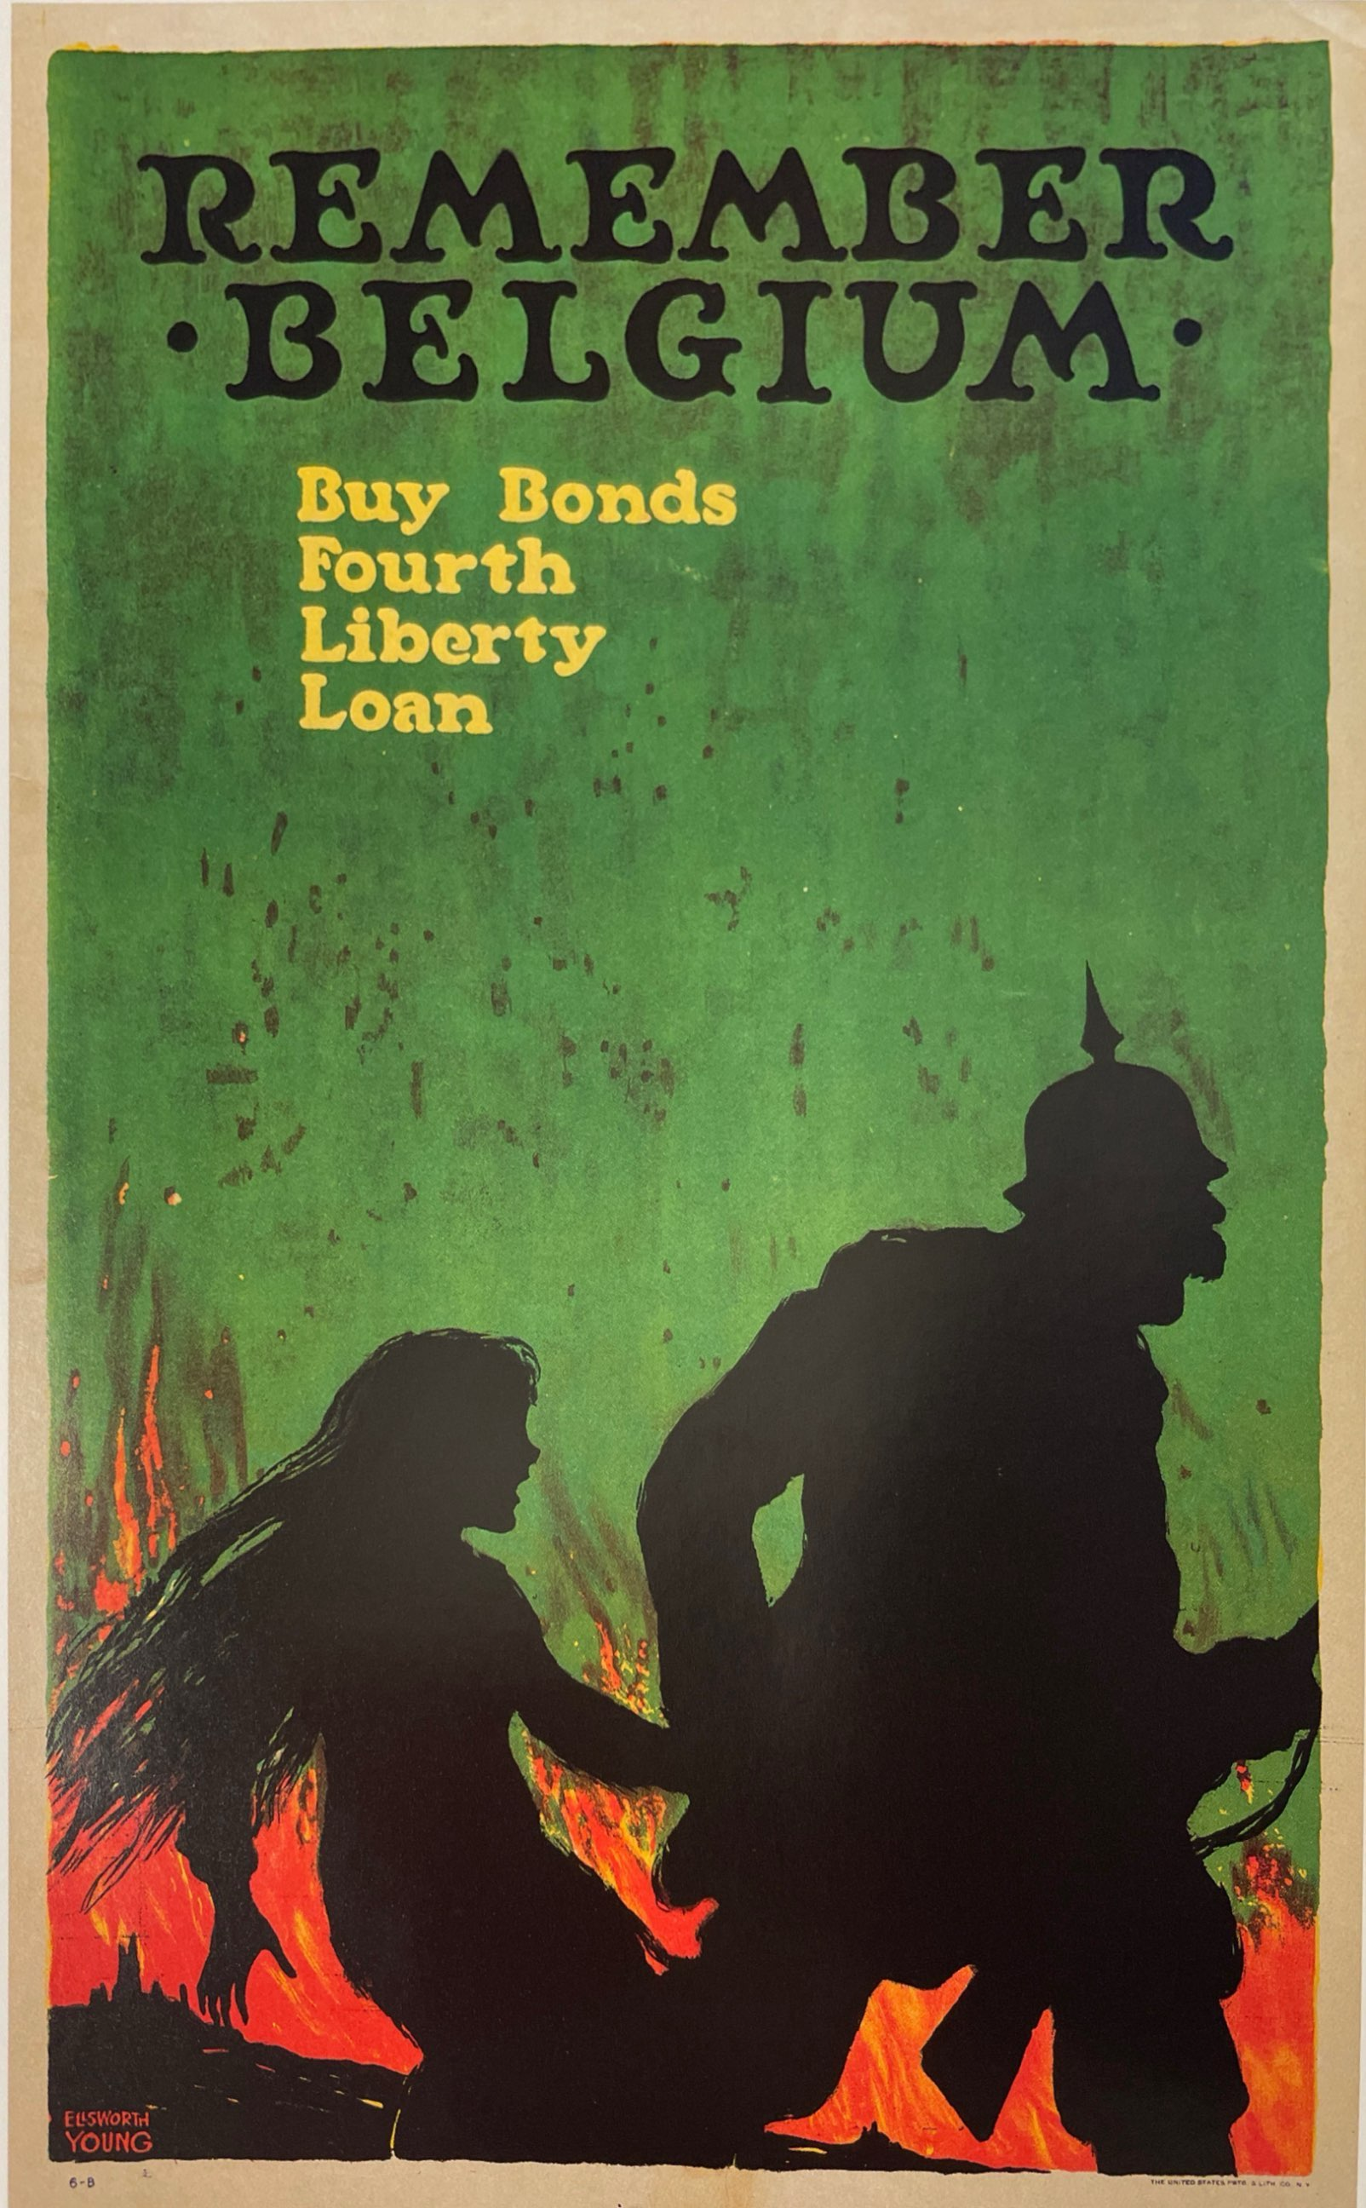
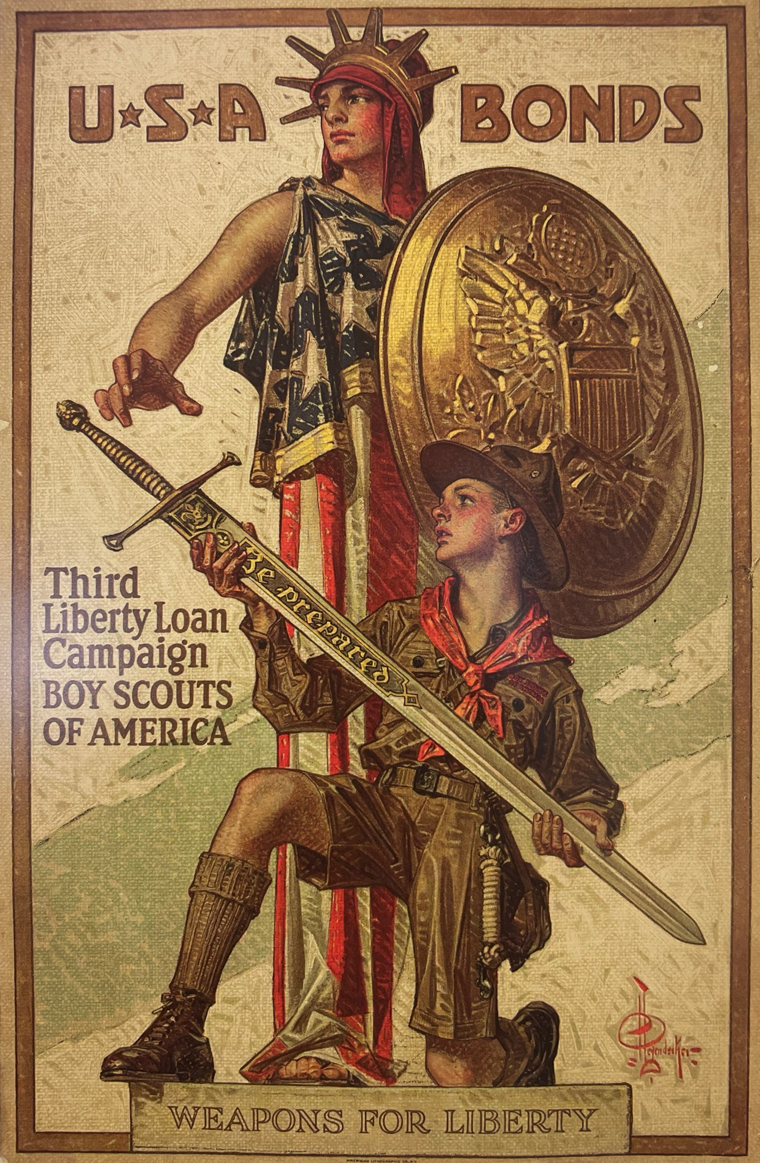
Us Mobilization
George Creel helped make a massive propaganda campaign that promoted war bonds, vilified Germans, and attacked slackers (people who didn’t sing up for the draft)
Selective Service Act
Attempted to make a “patriotic” way of implementing a draft
Required all men to sign up for the draft, but only some of them would be drafted
Allowed the military to choose more fit individuals
The drafting was carried out by locals instead of military officials to keep negative sentiment to a minimum
Seen as blacks as an affirmation of their citizenship, they were very eager to be drafted
The soldiers drafted in response to patriotism expected to be compensated after the war finished
War industry board was created by Wilson to have major control over industrialization
Helped free up factories tied down making weapons for the French and British

Slide 13
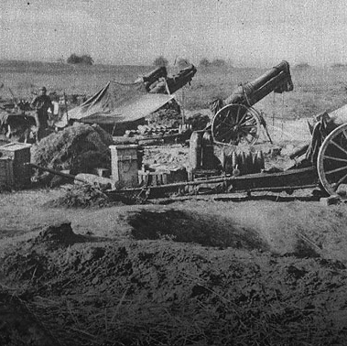
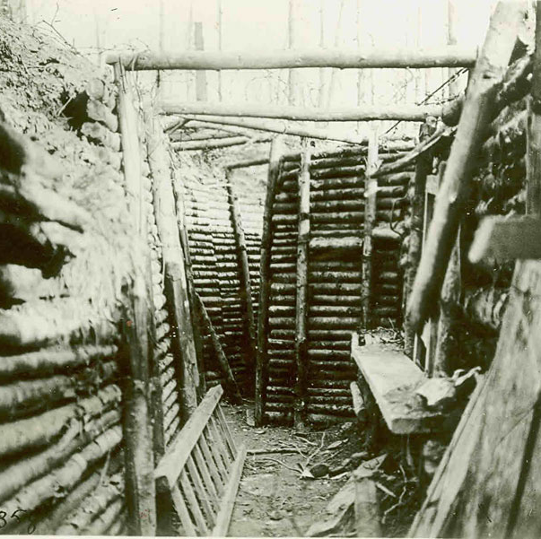
Combat
John J. “Blackjack” Pershing selected to lead the American Expeditionary Force (AEF)
Used to be a schoolteacher for black children
Selected because he didn’t put his own political beliefs over orders, and he was the only one to have recently commanded troops (1916 in Mexico)
Believed that because of the cadets’ level of discipline from Westpoint, he believed his army was both physically and morally superior
At the beginning of the war, his doctrine was “open warfare”
Maximum effectiveness of riflemen
Believed trench warfare was passive and wanted to maneuver
Quickly came to realize why trenches were used
At the beginning of the war, generals would move their men around in formation and they would be destroyed by accurate artillery fire
Only trenches were able to stop the massive number of casualties taken from artillery
Artillery was the king of the battlefield and technologies such as observation balloons and scouting planes only made them deadlier
Predictive firing caused was able to accurately predict artillery locations through triangulation
This allowed armies to move in without having to worry about enemy artillery

Slide 14
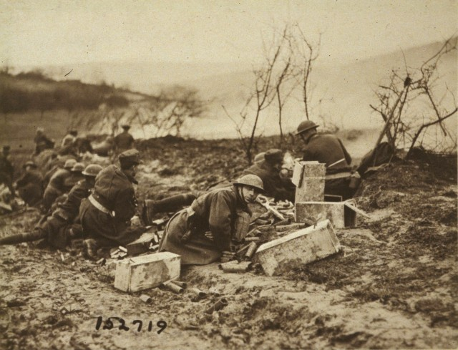
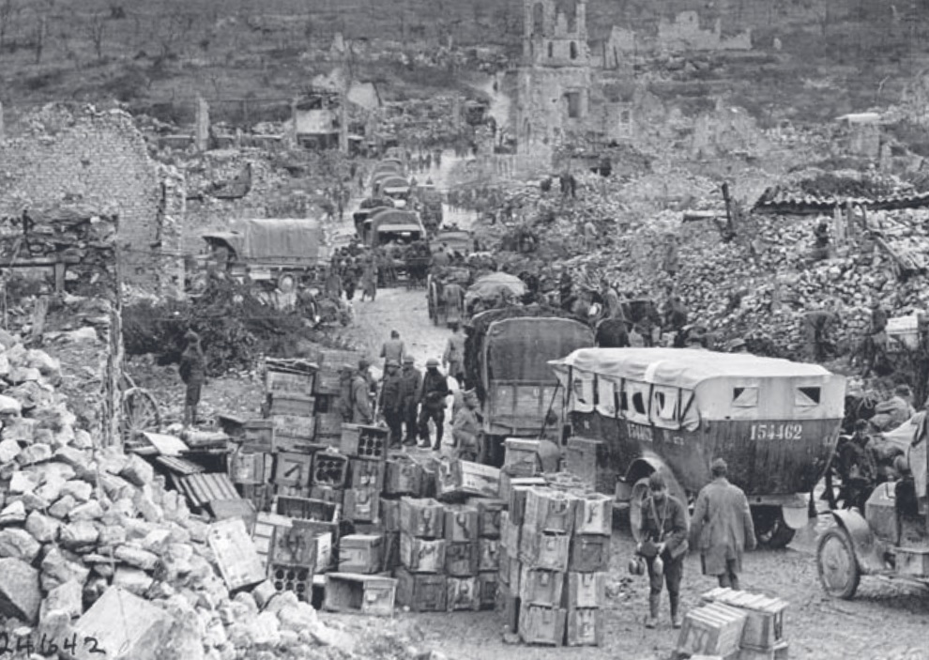
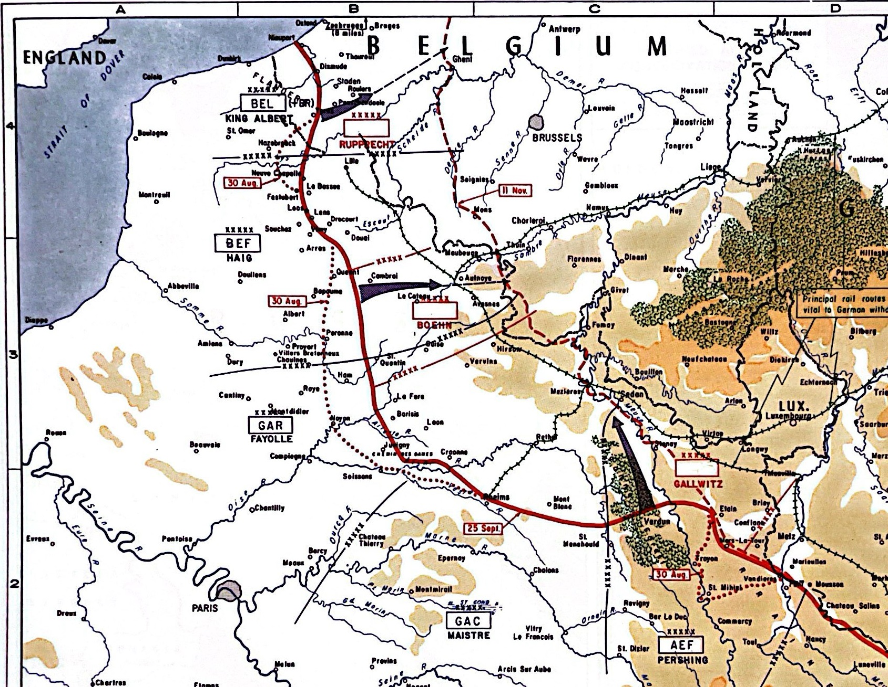
Because of German offensives in 1918, Britain wanted American armies to be in formation with
However, since America wanted to achieve her war goals, Pershing kept his distance with them
Pershing did help the allies by sending African American troops to help France
The only major battle the first army fought in throughout the war was during the Aisne-Marne offensive in the Meuse-Argonne battle
During this battle alone, the Americans fielded more artillery than the Union did in the civil war
During the time America was in the war, Pershing found out his open warfare doctrine had its issues.
Many occurrences of traffic jams happened, and troops would outstretch communications
To fix this, Pershing divided up his armies into smaller pieces to be more easily controlled
Promoted generals who caught his eye throughout the war
Eventually there was a ceasefire on the 11th of October 1918

Slide 15
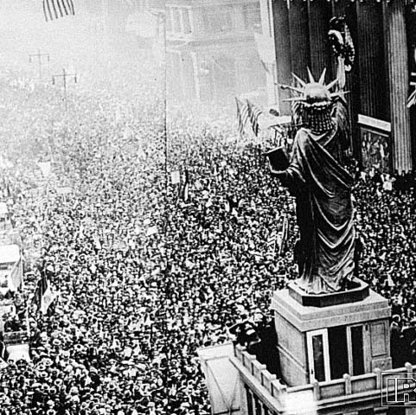
Outcome of the war
Since the AEF arrived late, the Americans didn’t get much of what they wanted at the peace deal.
Most of Wilson’s 14 points were rejected
America wanted to cooperate with the central powers, but the other entente powers decided to humiliate them
Even though the league of nations was created, the American government didn’t even choose to join it
Many draftees hated their experience in the war
The military police was harsh
This led to private investigators being required for court marshals
Many of them believed the civil service act didn’t deliver on the contract they made.
Led to veteran groups being made and eventually the GI bill being passed allowing for education and land for veterans

Slide 16
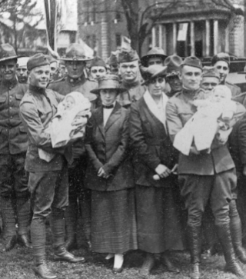
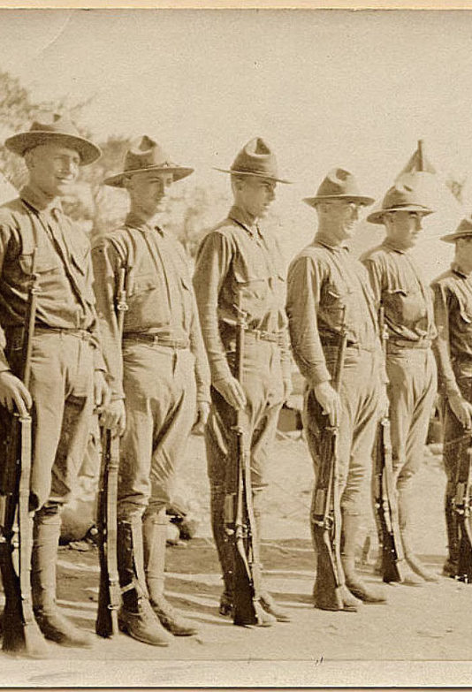
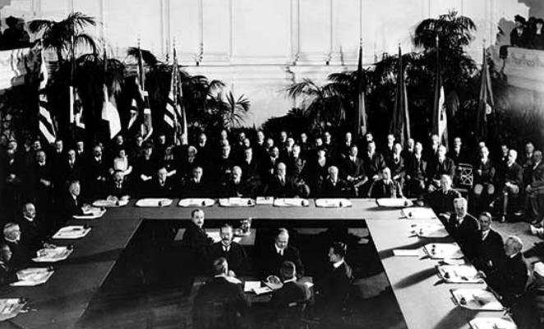
Interwar Years
US army applies lessons to the great war, but do they apply the right lessons?
What are the roles of air power as technology rapidly develops?
How can the marines survive with naval technology making them increasingly irrelevant?
Demobilization
Rapid demobilization: four million men to two hundred thousand
National defense act of 1920
Sets up the structure of the peacetime army
280,000 enlisted, 17,000 officers
435,000 national guardsmen
But congress doesn’t fund the army properly, leading to only half that amount being in the army
Chief of staff reminds congress that the demobilized nation, Germany, only has 100,000 men allowed to serve so that they are rendered useless
The USA only had 125,000 between 1922 and 1925

Slide 17
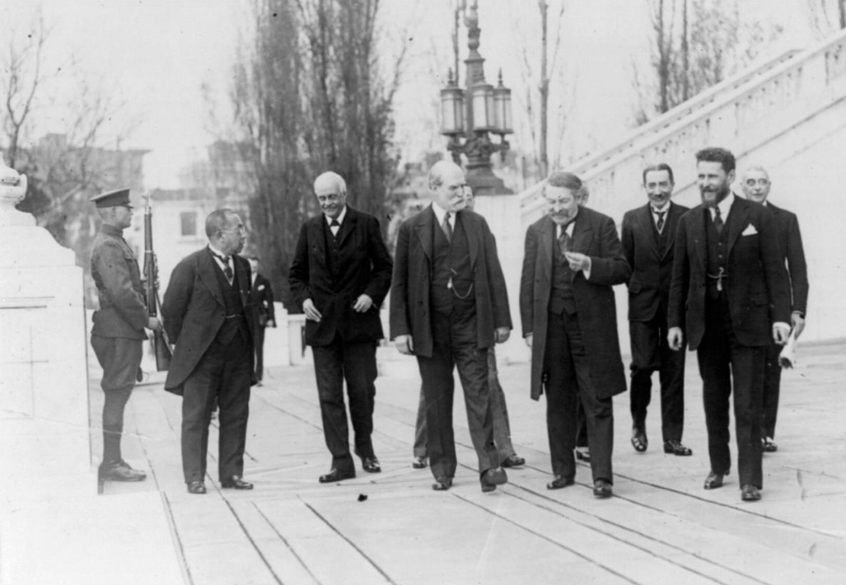
Navy
Current position: 2nd largest in the world, but will be largest upon completion of ships outlined in 1916 naval act
Leads to an arms race with Britain
Japan also expands navy rapidly
However, most Americans, including politicians, don’t want to spend that much money on ships
Secretary of state Charles Evans Hughes sends invitations to all the premier naval powers to have a conference in Washington
He proposes to end naval arms race and declares that the USA is scraping 15 battleships being built and 15 ships already built
Will limit the USA to 18 battleships
He calls on other powers to limit their number of battleships as well, getting the moral high ground
Everyone is shocked, but still agrees
This was the first successful arms restriction treaty in history
Gave a tonnage ratio of 5-5-3 for the USA, Britain and Japan, which left Japan mad
The treaty put no limit on submarines, which were seen as opportunities to give smaller nations a fighting chance
Allowed nations to have 2 aircraft carriers made from scrapped battleship hulls
Charles Hughes sunk more battleships than anyone else in world history

Slide 18
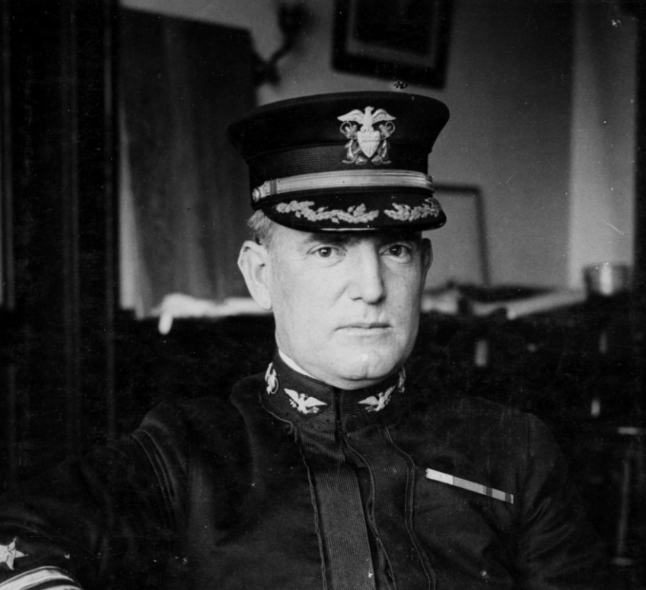
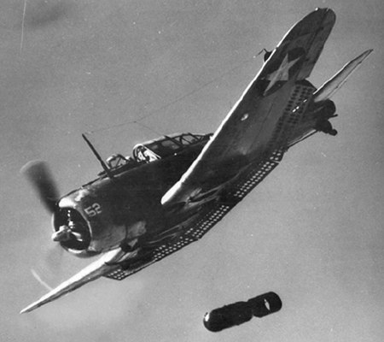
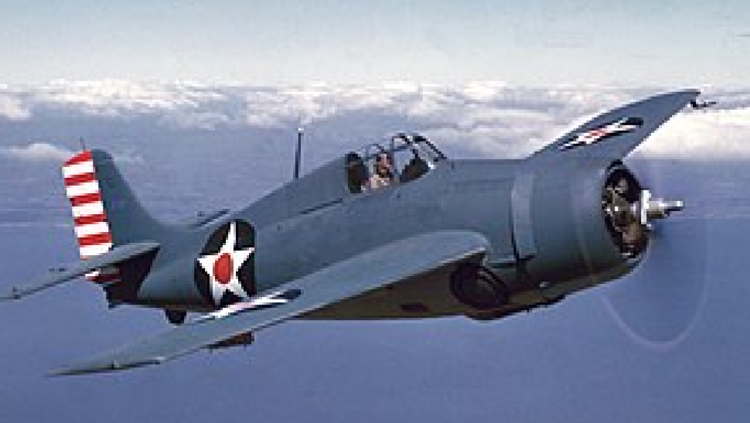
Naval Aviation
William A. Moffett is the head of the Navy Bureau of Aeronautics
Big advocate for carriers
Wildcat Fighter
300 mph max speed
845-mile range
39500 ft ceiling
Douglas Dauntless Dive Bomber
Near-vertical (80 degrees) dive
Bomb load of 2250 lbs.
Marines
Navy and Army didn’t see a need for marines
Marines were used to board enemy ships and police the navy, but these roles became obsolete with ships that could accurately fire from miles away and the navy accepting better men
Led to the marines being at risk of being removed as a branch of the military
John A. Lejuene and Earl Ellis decide to use the marines in amphibious landings
They knew that America would likely fight Japan, and that would mean they would need to be good at taking islands

Slide 19
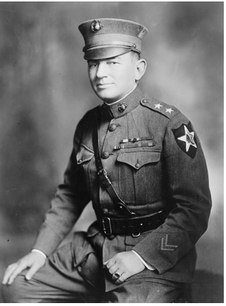
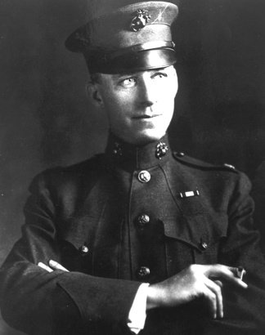
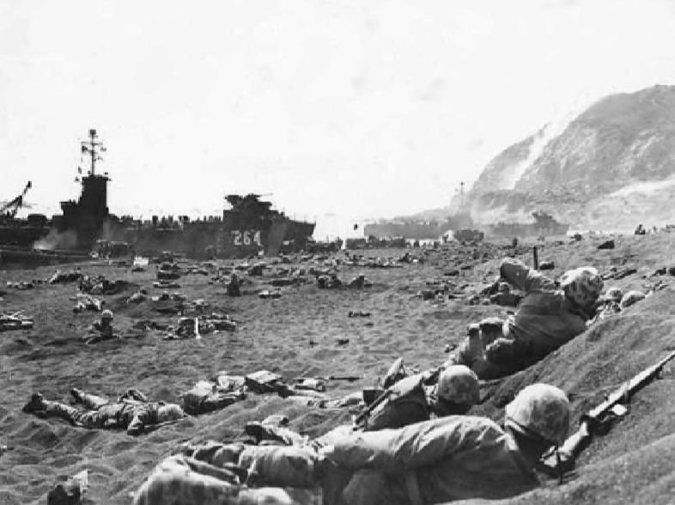
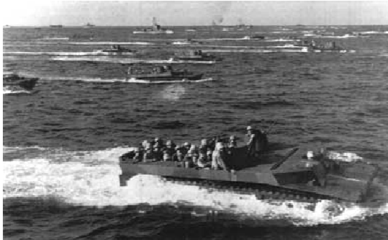
Amphibious Doctrine:
Unity of command between branches
Coordinating bombardments and air strikes over landing area
Landing craft will bring marines and support machine guns, light artillery and tanks
A concentrated beach assault will take the beach defenses, and a constant stream of supplies will allow the troops to move inland
Every Summer between 1935 and 1941, marines practice amphibious warfare

Slide 20
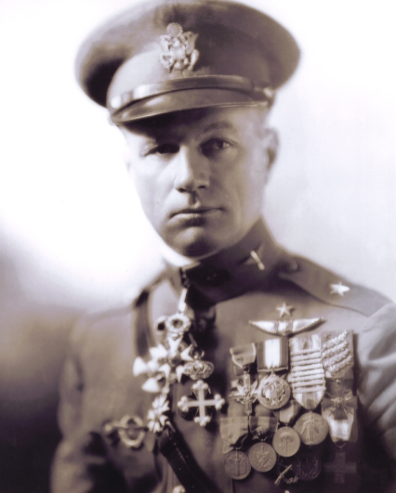
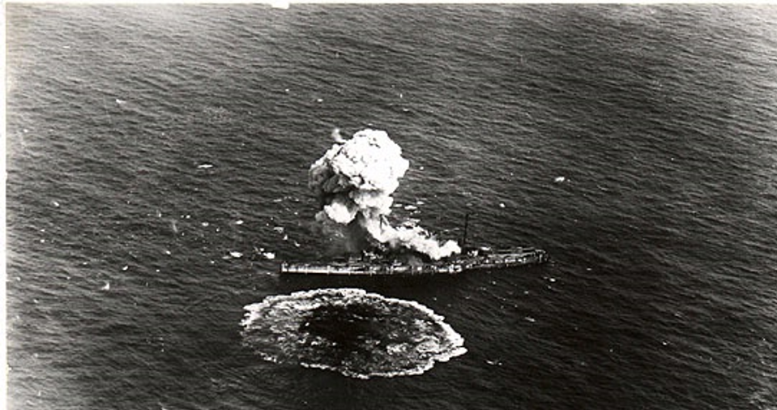
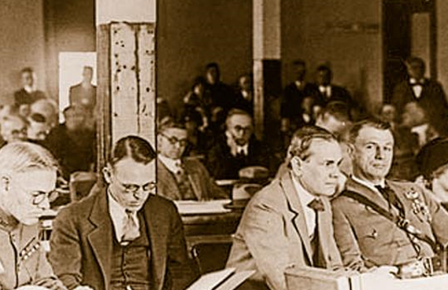
Air Power
Joint army-navy board discussed the future of air power in 1919
Concluded that air power should be in an auxiliary role to support infantry
Said air power would never win war
Aviation enthusiast Billy Mitchell extremely disliked this
Says the opposite: air power will win wars by itself
Believes whoever established dominance in the air will win a war
Believes there needs to be a separate branch for air power, and thinks that the navy will become obsolete because aircraft can just wipe out fleets
Demands that battleships stop being built
Some navy officials say an airplane can’t sink a ship, so Mitchell challenges them
Navy says to increase payload, but Mitchell drops it all at once
Mitchell leaks the result to the press and paints a narrative that ships are easily sunken by aircraft
Some obvious issues with this experiment: the ships weren’t moving or fighting back

Slide 21
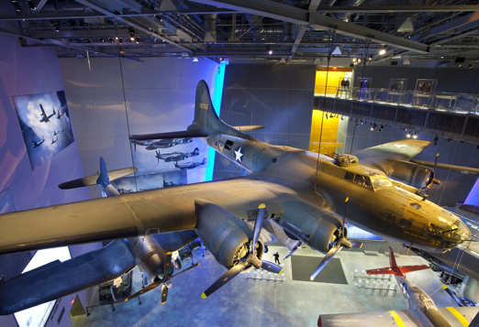
Billy Crosses the line
When a naval plane crashes, Mitchell declares leadership as treasonous and incompetent
Gets court martialed, convicted of insubordination, and resigns
Air doctrine in army: Strategic bombing
All aviation should be in control of air officers; the ground commander can’t directly ask for air support
Prioritize strategic bombing to destroy an enemy’s morale and economy
Most of the research is put into heavy bombers
B17 Bomber created.
10 crew members, 104 ft wingspan, 74ft length, 318 mph max speed, 3200-mile max range, 4 1000 hp engines, 4,200 lb. bomb load, ten 0.5 caliber machine guns
The air officers believe that in formation, these bombers cannot be brought down by enemy aircraft or anti-air guns

Slide 22


Tanks
Army’s assessment was that the infantry is still the heart and soul of the army
No one knew hoe technology would develop and how to use the knew technology
Led to the doctrine being to use them to support infantry
Eisenhower thinks this assessment is wrong, but doesn’t know how tanks will be used
The old guard censors Eisenhower because of his view on tanks
The designs made for tanks reflect the doctrine, not for fighting other tanks
German officer points this out when visiting the USA
M4 Sherman Tank was designed to accomplish this goal
Designed for speed, simplicity, and reliability and rapid manufacturing
Turret could be adapted for artillery, tank destroyer roles
50,000 produced from 1942-1945
The tactics developed for using tanks in battle resembled that of cavalry
Using speedy tanks to move through an opening created by concentrated firepower from infantry

Slide 23

WWII: Politics and Strategy
Supplying Britain
Germany has taken over the continent for the most part, and by early 41’, FDR knows that the USA will eventually join the war
In March of 41’, FDR and Churchill meet and decide to focus on Germany first
They view Germany as the stronger industrial power and conquering Europe has bigger consequences that what Japan could do.
FDR starts the lend lease program to give supplies to allied nations
Declares the USA as the arsenal of democracy
Battle of the Atlantic
Germany’s strategy is to use submarines to sink as much tonnage of British ships as possible
Karl Donitz, the German admiral uses wolf pack tactics, where subs will use radios to coordinate attacks on convoys
America starts escorting ships to Iceland and reports German sub activity off the East coast and in the Gulf of Mexico
Eventually a situation occurs where the USS Greer fires depth charges at a German sub
Instead of reprimanding the commander, FDR orders to fire upon all German subs while escorting convoys
The USS Reuben James is sunken off the coast of Iceland, which is the first American ship sunken during the war
This starts an undeclared naval war between the USA and Germany

Slide 24





Slide 25

Pearl Harbor
Before pearl harbor, the USA had frozen all Japanese assets in America and stopped selling oil to Japan
This is significant because Japan got most of its oil from the USA
To remedy, Japan’s natural resource issue, they decide to invade the resource rich Dutch and English colonies
To accomplish this goal, a pre-emptive strike against America was planned to stop them from interfering for at least 6 months
Some assumptions made by the Japanese to make this seem like a good decision:
The USA would not wage total war to recover the Philippines
The USA will do a negotiated peace if they get a decisive victory at Pearl Harbor
The USA is more committed to Europe than Asia
Admiral Yamamoto was put in charge of the strike
Goal is to cripple the US fleet at pearl harbor
Given 6 aircraft carriers and 350 planes to do so
How did the USA get caught off guard?
Army and navy bases didn’t coordinate well with each other
Army hadn’t thought about a possible aircraft attack, was more worried about Japanese spies or demolitionists
Warnings on the day of the attack were ignored
Left 2,500 dead, 200 aircraft destroyed, 5 battleships and 3 other ships

Slide 26


Disaster for Japan
US aircraft carriers were on patrol and not destroyed
3rd wave of bombers called off because the Japanese didn’t know where the carriers were
The attack didn’t debilitate the US for 6 months, they don’t force a peace, and the USA is determined to defeat the Japanese

Slide 27




FDR and Strategy
Prior to being president, FDR had been the secretary of the Navy
FDR was a pragmatist; he liked to experiment with tactics
Would override commanders when he wanted to
Wanted to fight a war of production and machines
Believed that Naval and Air power were just as important as land battles
Wanted to produce as much as possible for all three elements and destroy enemy equipment before it reached the battlefield
Flags aircraft as the number one production priority
Out of all major belligerents, the USA lost the least number of men, but spent the most money
Only 1/6 of the total male population was put into uniform, much less than others
THE USA only took 1 year to reach full military production, while others took 4-5

Slide 28



During the war, America made 86,000 tanks, 120,00 artillery, 2.4 million jeeps, and 82,000 fighters
The sacrifice of millions of Soviet men allowed the USA the time to crank out the material that would win the war
American military industry was exemplified by Ford’s Willow run factory
Continuous 5,450 ft assembly line
In 1944, one bomber was made every 63 minutes
This amount of production was possible because the USA was the only nation distant enough from the fighting to avoid bombings
The only deaths due to war on the American mainland were experienced due to balloons Japanese children in class made that had bombs attached to them. The Winter jet stream carried the bombs to the Pacific coast where one killed a few people

Slide 29


Women and Combat
With the departure of men, women were encouraged to work in factories and in clerical positions in the military
WAVES were women who helped with war in the Navy
Did engineering jobs, were radio operators and mathematicians
Encoded and decoded 75% of encrypted messages the came to and from Naval Operations
By 1945 were 20% of shore personnel
Marshall experiment: experiment to see how women act in anti air roles
Report concluded that women were better than men
Had better motor skills, attention spans
However, even with the experiment, congress didn’t allow women to work as anti air gunners
Other countries had similar roles for women, except the USSR, which had them fight as snipers and in anti air roles

Slide 30



Germany or Japan first?
FDR decides not to go fully Germany first
In his May 6th memorandum, says he will hold line in Pacific, but will do attacks against Japanese shipping if opportunity arises
Chief of Staff Leahy and Ernest J. King were advocates for a Pacific first strategy
Leahy was the most powerful man in naval history; he commanded the fleets and the operations
Saw China as an important area after the war, wanted to make sure Japan or Britain didn’t get their hands all over it
King lied to FDR to get more forces in the Pacific by using misleading statistics in reports
Alliance Troubles
America wanted to attack the strongest point of German defenses, of France
Britain wanted to take out North Africa and Italy
Soviets wanted troops in France as soon as possible
Churchill convinces FDR to attack North Africa by telling him only British forces would be attacking the beaches since America had no force there.

Slide 31



WWII: Pacific
In the first 6 months of 1942, Japan captures the Philippines, Malaya and Dutch Indonesia, giving them access to the natural resources they desired
USA makes their main base Australia, so they need to secure the shipping routes between there and Hawaii
Initially Japan has the naval advantage in the Pacific
12 vs 9 battleships, 9 vs. 3 carriers, 7,500 vs 700 warplanes
Japan wants to have a decisive battle to stay on the offense
However, by mid 42, ~60% of the Japanese code is somewhat decipherable
Chester Nimitz put in charge of Pacific fleet
Texan, submariner in WW1
One of the most effective commanders in the war
Calm with people, but an aggressive commander
With peal harbor being a disaster, most stationed there expect to be fired
Nimitz gets the respect of everyone there by not firing anyone, just moves them around

Slide 32


Admiral Yamamoto’s plan for a decisive battle
Mistakes USA for cowards, doesn’t realize they are just waiting to build up their navy after Pearl Harbor
Thinks he must lure them out with a small force to get a battle, so he develops this super complicated battleplan to attack Midway island
USA figures this out due to the code being deciphered
Nimitz believes a surprise against the Japanese navy will offset their carrier advantage
Some carrier plane information
CAP (Combat Air Patrol): fighters that defend carriers
Torpedo bombers: drop torpedoes at low altitudes to destroy ships
Need escorts
Dive Bombers
Drop bombs accurately by diving onto targets at high degrees
Usually do it going away from the sun to make it hard for anti air guns
Battle of Midway: 4-6 June 1942
4 Japanese carriers strike airbase on Midway island, destroying planes there
Torpedo bombers from Enterprise and Hornet launch an uncoordinated attack and are destroyed
Dauntless dive bombers attack carriers while CAP is distracted, destroy 3 carriers
Last Japanese carrier launches bombers that fatally wound Yorktown
Final wave of bombers launched by Americans, sink last Japanese carrier
Both Richard Best and Dusty Kleiss score 2 hits on enemy aircraft carriers
Significance of Midway
Japanese are on defensive for the rest of the war
Losing 4 aircraft carriers is a huge blow for Japan, who can’t make them as fast as America can

Slide 33


Slide 34

Guadalcanal – First American Offensive
On periphery of Japanese Empire, in Solomon Islands
Japan was planning on using Guadalcanal to bomb Australia
Most even battle America fights during the war; takes 6 months
Many naval battles occur during this campaign. More American naval ships are lost here than anywhere else in the war
Japan losses too many experienced fighter pilots, can’t replace them with new ones
The pilots they try replacing them with are too inexperienced any many crash on their way to Guadalcanal
Japan losses tons of equipment on the way to Guadalcanal
Nimitz says How he wishes the Japanese never leave Guadalcanal
Divided Command: Macarthur vs. Nimitz
Macarthur is the highest-ranking military personnel in the Pacific theater
But Nimitz and Navy believe the sea battle is more important, and thus should get their way
MacArthur is controversial, but generally loved by the public
Shot tanks at protesting WWI veterans
Loves talking to the media
Macarthur wants to prove his honor by retaking the Philippines
Proceed by invading Japanese-controlled China, then bombing Japan
Navy wants to do a more direct route by doing amphibious landings throughout the Mariana Islands, then taking Iwo Jima and Okinawa
FDR allows for both plans to take place simultaneously

Slide 35


Marine Naval landings
First large one on Tarawa Atoll in Nov 1943
Naval bombardment only occurred for 3 hours to not draw suspicion, but the Japanese defenses were still strong
The landing was largely uncoordinated, supplies didn’t arrive on time
Landing craft got stuck on reefs, marines were forced to walk through the water
Heavy casualties were sustained over 3 days
Lessons from this landing were applied during the rest of the Pacific war, in North Africa and D-Day
Longer bombardment
Ariel attacks from Army air corps
JASCO companies to synchronize fire
Light tanks, flamethrowers, and bazookas needed to be utilized

Slide 36



Slide 37



Politics of Strategy
Army and Navy fight over who should get preference for their campaigns
Joint Chiefs of Staff decide that the Marianas are more important because then planed could be used to bomb Japanese industry and convoys
MacArthur doesn’t line this, says to Roosevelt that he will resign and run for president if the Philippines are abandoned
FDR goes to Hawaii to solve the issue, and MacArthur is allowed to invade the Philippines
Battle of Philippine Sea (Around Mariana Islands)
Japan realizes the significance of losing the Marianas
USA fights a defensive battle to secure their landings
Japan sends wave after wave of inexperienced fighters to no avail
Nicknamed the “Great Marianas Turkey Shoot” by American pilots
American victory, bombing of Japan is now possible

Slide 38

Invasion of the Philippines
MacArthur sees the airstrip on Peleliu as a threat to his invasion, so he sends the 1st marine division to take it out
Inadvertently, this lets the Japanese know that the Philippines are going to be attacked, so they move many troops into the area
This leads to the invasion not being as quick as MacArthur promised, and the Philippines still haven’t been taken by the time the war has ended
Submarines Sink the Japanese Empire
US uses unrestricted submarine warfare against Japanese merchant fleet
Unrestricted submarine warfare is when you don’t let a ship know ahead of time that you are sinking it
All nations use unrestricted submarine warfare throughout the war
Initially there are problems with American submarines
Many are outdated, don’t have fuel storages for long voyages, lacked AC, the torpedo being used (Mark XIV) was defective
1943 Turnaround
American submarines started operating in groups of 6-7 instead of individually, making prey easier to pursue
New Guto Class submarines fixed issues that the S class had
By the end of the war, 40% of the Japanese merchant fleet had been sunk

Slide 39


WWII: Mediterranean and Strategic Bombing
Operation Torch: Plan to take back North Africa
Landed in Algeria and Morocco, met with the British in Tunisia, and Pushed the Axis out of Africa from there
Lots of issues
In landing, supplies didn’t arrive in the correct order
Many men had to be removed due to psychological breakdowns or sickness from nervousness
The tank doctrine was a failure, German tanks completely outmatched the American ones
In the battle of Kesserine Pass, an American tank shoots a German one 18 times, and the German tank still doesn’t have a scratch

Slide 40


Dwight Eisenhower
Tanker in WW1, but never made it overseas, so he didn’t have any combat experience
Took lessons from North Africa to improve army
Had to communicate with Britain better, fire officers, make logistics work
Invasion of Italy: July 1943
Took Sicily and quickly moved up the Italian peninsula but were halted by a strong German defensive line.
World War 1 tactics ensued, leading to minimal gains.
Allies only take Rome in June of 1944

Slide 41





US Army Airforce arrives in Europe
Cark Spaatz moves to London and establishes the 8th Airforce
British by this time have given up daytime bombing and have resorted to nighttime morale bombing
USA Insists on using precision daytime bombing with the B-17 and Norden Bombsight
The first American bombardment was on August 17, 1942, in Rouen, and it was a major success.
Only one dead and some bombs landed near the target

Slide 42

Spring 1943: America starts bomber offensive against German land
Combined Bomber Offensive: first coordinated plan for strategic bombing in history
List of 76 targets with the German aircraft industry being the top target
British bomb at night, Americans bomb at day
British planes had an easier time surviving but were much less accurate. They saw killing civilians as fine to instill terror.
Also, they dropped aluminum strips from under the plane to disrupt German radar
American daylight precision bombing saw success destroying key German industrial plants
Destroyed a ball bearing plant that was key for German air production in August 1943 (Schweinfurt-Regensburg)
At this point, fighters couldn’t fly as far as the bombers, so escorts were not possible, leading to high casualty rates among strategic bombers
The expected casualty rate was 4%, but was closer to 20%
Despite the losses the Germans were inflicting on the Americans, the high command of Germany was still terrified of the bombers.
A lot of German military production was shifter to fighters to defend the skies over Germany
70% of fighters were used to fight off bombers over Germany and were not used against the Soviet Union, causing them to lose air superiority in the East.
New Priority: destroying the German air force
January 1944: Message sent out to destroy enemy Airforce wherever they are found
New Tool: P-51D Mustang
American design with British engine
Had a range of 1800 miles, so it could escort bombers to Berlin
The main tactic used was to send the fighters ahead of the bombers to scout for enemy fighters and pick fights with them
German fighter pilots were terrified of the P-51 Mustang , and when command asked for more fighter patrols, the pilots revolted.
General James Doolittle
Decided to narrow down targets to aircraft factories, war industry, petroleum and transport targets

Slide 43



Morality of strategic bombing: Is it ok to cause huge amounts of civilian casualties?
Practical argument against strategic bombing: The Germans had such a tight grip over society that instilling fear would do nothing to pressure the war to end
Air force’s argument for bombing: less people will die overall, and the war won’t last as long. Bombing might cause society to collapse
1944 Clarion Plan: destroy transport facilities to show that the allies had complete control over the air

Slide 44



WWII: D-Day and the Bulge
General Eisenhower drafts Operation Overlord (D-Day)
A main component of the operation is deceiving the Germans into thinking they are attacking at Calais
Patton is put in charge of a fake army that is stationed across from Calais.
Husks that look like machines are positioned, fake orders are given to fool Germans
Allies give fake information to known German spies that the main force will attack at Calais
Hitler falls for it, as he already believed the attack would come there
Most paratroopers land off target, which further confuses the Germans as to where the landing is happening
When troops do land on June 6th, Germans take time to reinforce the defense, as they still believe a stronger force will land at Calais

Slide 45




Point-Du-Hoc (defensible position between Utah and Omaha beaches)
First Americans to complete their objective were Rudder and a group of rangers that consisted mostly of Aggies
Took out German guns and prevented reinforcements with a great amount of casualties

Slide 46



Attrition and envelopment
Shortly after landing, the British and Canadian forces got bogged down near Caen
The bocage, a farming region where farms were separated by thick hedge walls reinforced with stone was easily defensible. Commanders were afraid of combat resembling WW1
By the end of June, General Bernard Montgomery (British) was facing 7 ½ German armored divisions and 700 tanks, while the Americans were only facing ½ an armored division and 140 tanks

Slide 47



Some tactics the armed forces used to attack in the Bocage region

Slide 48


Operation Cobra: Breakthrough the Bocage
Omar Bradley in command of operation
American officers preferred assaults over a large area all at once, but Bradley found a weak spot ans wanted to use tanks and planes to breakthrough
Carpet bombing the weak-spot:
Napalm dropping by Thunderbolts – 50 at a time every 2 minutes
Medium bombers attack
1500 flying fortresses and liberators destroy everything remaining
Small fighters drop small bombs
These raids kill or wound 70% of the Germans in the area
Tanks and mechanized then breakthrough German lines and push through the German front
Patton’s 3rd army envelopes German forces, only some escape

Slide 49



Patton
From a wealthy Californian family
Aid to Pershing in WW1
Leadership style combines digestedness with encouragement
Takes Brittainy in 72 hours
By August 25th, allies capture Paris
In November of 44’, Patton pauses offensive to regroup

Slide 50



Battle of the Bulge (Largest battle in American Military History)
Hitler orders counter-attack in December of 44’
Starts attack in terrible weather to minimize allied air superiority
Eisenhower’s defense strategy
Hold Bastogne at all costs; it is a transport hub
Use Jeep to transport men quickly to the Bulge
Unprecedented movement of 200,000 troops to the front line in the 1st week of fighting
Counter-attack works, Germany is doomed

Slide 51

Yalta Conference
Allied forces converging on Berlin; allied leaders mead in Yalta in February of 1945
Stalin held all cards, as they were closest to Berlin
Stalin demanded and got control of Eastern Europe
Atomic Bomb
USA able to focus on Japan once Germany falls
Strategic bombing of Japan
After taking the Mariana islands, it was possible to bomb mainland Japan
However, this was made difficult because of a radio station on Iwo Jima
Curtis LeMay made new strategic bombing coordinator
His strategy is to use nighttime low altitude firebombing
He also has carriers perform bombing raids
Even with the firebombing and carrier strikes, Japan still wouldn’t surrender
Operation Olympic: First plan to capitulate Japan
Blockade and bomb until they give up (but they weren’t going to give up)
Operation Downfall
Correctly assumed that Japan wouldn’t surrender due to operation Olympic
Operation Olympic would be the first phase of Downfall, followed by an invasion of Japan
1,137 warships, 15,000 aircraft and lots of landing craft were going to be needed for the invasion
At the time the plan was made, no one doubted this would happen

Slide 52


12th April 45’ FDR dies, and Truman comes into office.
Truman decides to use the Manhattan project
He had no doubt the bomb would be used against Japan
Choses to use the bombs as a surprise attack
The firebombing has already killed hundreds of thousands of people, so why not just use the nuke
The Hiroshima bomb kills 40 thousand instantly, kills 100,000 more from burns and radiation poisoning
Japan didn’t believe what had happened until the second bomb was dropped
Only after the second bomb Japan surrendered at request from the Emperor

Slide 53
With The Old Breed
Sledge is in the 1st division, 5th marines, 3rd battalion, K company
Why did Sledge enlist in the Marines?
Sledge wanted to enlist and fight during the war, but also didn’t want to be an ordinary enlisted man. He was in college, so he could have gotten a technical position if he waited until graduating. But he also believed that the war would end before he would finish college, and thus, he wouldn’t fight. So, when an enlistment officer offered him an opportunity to join an officer training program, he enlisted.
How did Sledge’s training prepare him for combat? What training techniques did the Marines use in boot camp and on Pavuvu?
The way Sledge described boot camp is very similar to how it is portrayed in movies. Drill Instructors harassed men to no end, and drills were carried out all day. However, Sledge’s hindsight he provides explicitly tells us how these processes prepared him for war. Staying up for 18 hours every day prepared him for battle where you would only get sleep once you died; keeping sharp ears allowed for quick actions once orders were given or detecting Japanese infiltrators at night.
In Camp Elliot and Pavuvu, the training sledge went through was more oriented towards operating weapons. He was taught how to use mortars and flamethrowers. Towards the end of the regiment’s time on Pavuvu, the tasks the officers made them do were tiresome. This was intentional, as they were about to head to Pavuvu, and the officers wanted them angry and ready to fight. All of Sledge’s seasoned peers knew this was the case.
What techniques did officers use to train and discipline the men? What leadership traits did Sledge admire in his officers? What were examples of poor leaders?
During boot camp, the drill instructors made lots of threats, so men stayed in line. Upon finishing bootcamp, there is an instant change in how the officers consider the marines, with the officer giving them the speech after bootcamp calling them men for the first time. From then on, the marines are still disciplined, but they aren’t harassed or berated as much as before, as both the men and the officers know they are the “best of the best” as marines and acted accordingly.
Sledge appreciated officers that outwardly showed that they cared for the men. Sledge admired Captain Haldane because of his attempt to get to know every man under his command. On top of that, he appreciated officers who were reassuring like his mortar teacher at Camp Elliot.
Haney is a good example of a poor leader. He is pretty unrelatable with his questionable hygiene routine, and before the battle of Peleliu, he hogged one of the only two restrooms available for the marines to use.

Slide 54
How did Sledge and his fellow Marines view the enemy? How did they treat the enemy?
They knew that the Japanese would do anything to win, like faking surrender at the beginning of the war. So, the marines knew that they would have to use backhanded tactics as well.
Other marines seem to treat the Japanese worse than Sledge. on the initial beach assault on Peleliu, Sledge finds some dead Japanese soldiers, and some of his fellow marines use that time to loot the corpses. Sledge is shocked that the soldiers don’t seem to care about the dead, and this shows a difference in view between him and some of his fellow soldiers.
Even though Sledge dislikes the enemy, he still values them as human and that makes it difficult to see them in pain. While he still does his duty as a soldier to take out the enemy, seeing them dead or in pain leaves him with disgust and regret.
After the company takes out a pillbox full of Japanese, they use the downtime to loot the corpses, taking knives, flags, and golden teeth. Sledge views these actions as barbaric and likens them to Indian warriors scalping their enemies. One guy even tries to take out a Japanese guy’s teeth before he had even died.
After Sledge saw the carcasses of marines that had been mutilated and humiliated, he never felt any remorse for the Japanese through the rest of the war.
What were the Japanese tactics on Peleliu? How were they different than what the Japanese had done before?
In earlier assaults, the Japanese would meet the marines on the beach with banzai charges and get slaughtered in the process. On Peleliu, the Japanese commander switched up the tactics by spreading his men throughout the island in caves and holes to catch Americans off guard. Sledge also notes how the Japanese had refined their infiltration tactics to be more effective.
To evade American scouts, the Japanese would only fire their artillery when they could inflict maximum damage. Immediately when their firing ceased, they would close the steel doors that housed their guns to avoid being destroyed by American weapons.

Slide 55
What were the various emotions that Sledge felt during battle? What were his worst moments?
Sledge’s worst moment came during Peleliu, where on the day after D-day, his group of marines had to storm the airfield. Shells were landing everywhere, and the marines had to go through an open field with no cover, spare a few craters. Also, there weren’t any machines supporting them, which made the task even more difficult.
During the amphibious assault on Ngesebus, Sledge and his group were attacking a pillbox, some Japanese soldiers came out with bayonets and charged them. Sledge describes how he felt excited and curious at the same time. This is unique because most of his time in battle is spent being worried. It was probably because after the entire time that they were trying to take out the soldiers in this pillbox, some of them just gave themselves up by doing a suicide charge.
During that same pillbox sequence, an amtrac comes to help the company and destroys the fort. After this happens, a Japanese soldier comes out running, and Sledge shoots him. This is the first time that Sledge is close enough to see someone he’s shot react to the pain. It fills him with shame and disgust. Sledge recognizes that this view is likely different than his fellow soldiers and is thankful that they can’t read his mind, as he wishes that he wasn’t overcome with these feelings.
What went wrong and what went right for Company K during the fighting on Peleliu? What was the typical pattern of attack for a rifle company?
At the beginning of the battle, Sledge’s battalion lost communication with the surrounding forces, leading to them to push farther than them and exposing their flanks. This caused a Sherman tank to assume that Sledge and his company were enemies and got fired at by their own men.
Another thing that went wrong happened during the night when a couple Japanese tried to infiltrate the foxholes. They didn’t accomplish much, but Bill was injured, and another man mistook him for a Japanese in the night and killed Bill. This was especially gut-wrenching to the marines because this could have been avoided if Sam had stayed up all night
Generally, the battle of Peleliu was bad for the marines. K company suffered 64% casualties and only 2 out of the 7 officers made it back to Pavuvu. With that being said, the attack on Ngesebus went well, with only a handful of marines being taken out compared to the large number of Japanese killed.
The typical attack pattern for a rifle company goes like this: One or two mortars would fire on areas known or thought to harbor enemies. Light machine gun squads would fire on areas in front of the rifle platoons. Two out of the three rifle platoons would then move out in dispersed order, while the third was held in reserve. The mortars and machine guns would stop firing and the riflemen would move towards the objective. The machine guns would follow the riflemen, and the mortars would support if there was strong opposition.

Slide 56
What sights, sounds, smells, and physical touches on the skin were particularly difficult for Sledge? How does he try to explain the sensory experience of combat?
The first time Sledge saw a dead Japanese man with his guts open, Sledge couldn’t believe what he was seeing. He stood there in shock as some marines looted the corpses.
Sledge described hearing the artillery shells as the worst thing he had to endure throughout the war. To relate these experiences to the reader, he is very descriptive of every aspect of the shells, and makes analogies to experiences that non-soldiers would have experienced, like thunder
One of the toughest experiences for Sledge during Okinawa was fighting against the Shuri Line. The fighting was so rough in that area that it was impossible to retrieve all of the marine corpses. This took a huge toll on Sledge mentally, as he states that "I had heard and read that combat troops in many wars became hardened and insensitive to the sights of their own dead. I didn't find that to be the case at all with my own comrades." (Page 250). Sledge makes note of how disturbing seeing a group of 6 marines dead in the mud was to him.
What did the Pacific environment contribute to the suffering of the Marines?
The extreme heat the marines had to endure was a huge difficulty to overcome. This exacerbated the water scarcity that plagued the marines and led to dehydration and heat exhaustion. The heat was so bad that four men were needed for each stretcher when recovering the wounded.
In a lot of scenarios, advancing on the enemy was difficult. The terrain made it hard to dig in, being that there was only a layer of sand covering coral rock, which was impossible to dig into.
The heat and humidity of the Pacific made the stench of decomposing bodies horrible. They would start stinking hours after death, and there was no way to stop it because of the lack of a layer of soil to cover them with.

Slide 57
What was different about Okinawa from Peleliu? What was different about Sledge in combat?
To start out, when the marines landed on Okinawa, there was no Japanese resistance. They had amassed all their forces in the South of the island. When fighting did occur, the Japanese made greater use of artillery and mortars. They also tried counteroffensives more frequently than in Peleliu. The biggest Japanese counteroffensive tried to take out the entire 1st Marine division.
Sledge was much more composed in this battle than he was in Peleliu. The sights he would describe were worse, but he didn’t go into as much detail on what they did to him mentally, had been through it all. Early in the battle, when he saw a Japanese man’s intestines strown all on a tree, he just made a note of how disgusting it was and moved on. Sledge does recognize that his composure was tested, as there were people all around him getting combat fatigue, including some people who were more experienced than him. Even through all of this, Sledge promises to himself that he won’t break mentally, and does a great job not losing his mind.

Slide 58
The first video asks you to consider Nagumo’s Dilemma – whether to send an immediate strike or send a strike after recovering Tomonaga’s force. What did you decide and why?
With hindsight, the correct choice was the risky one. With the information given, sending the strike afterwards seems like the best option, but could you really trust the scout plane’s information? After all, it was allegedly 60 miles off the path it should’ve been on. And you didn’t even know the composition of the force? The author of the video even said how that task force likely had a carrier in its composition due to its location and direction.
The third video discusses Fletcher’s Decision. What was it and why was it a good decision?
Fletcher was given information from one of his scout planes that there was a Japanese carrier task force Southwest of him, but the scout had reported only 2 carriers, which was not as many as expected. Playing it safe, he left the Yorktown’s planes in reserve to guard against any unknown air squadrons. This attack was good because it put the initiative in the hands of the Americans while not being a huge risk
What were the two lucky breaks the Americans got during the battle?
Task force 17 should have been spotted by a Japanese scout plane, but cloud cover prevented the Japanese from seeing it. (Japanese scouting really lost them the battle).
McClusky had a decision to move either Southeast or Northwest after reaching the interception point and seeing that the Japanese carriers weren’t there, he correctly assumed that the Kido Butai had been caught up dealing with Midway’s plane forces. This led him to find A SOLE JAPANESE DESTROYER WHICH HAD BEEN CHASING A SUBMARINE. The air squadron then followed the destroyer, AND PERFECTLY TIMED THEIR STRIKE WITH THE YORKTOWN’S AIR SQUADRON, dooming 3 Japanese carriers.

Slide 59
What did watching the battle unfold in a series of animated maps teach you about why the US forces won the Battle of Midway? Include two thoughts from each of the videos.
One of the big reasons the Americans won was the poor Japanese anti-air technology. This made it impossible for the Kido Butai to launch strike forces during defense due to the evasive maneuvers the carriers had to perform.
Another was the lack of information the Japanese had. Nagumo had incorrectly assumed that the carriers were still in port at the beginning of the battle, with his reasoning being: It wouldn’t make much sense for the carriers to be on patrol. His lack-luster scouting had given him inconclusive information that he trusted.
The Japanese aggression in closing the distance to win the battle cost them the Hiryu. The short-sightedness of the Japanese command to try their hardest, not taking time to think that one Japanese carrier was worth much more to them than one carrier was worth to the Americans, let them not able to fight another day and cancel the operation
The poor fire fighting ability of the Japanese didn’t allow the 3 carriers to have a chance at survival and fight another battle.
The Americans had a good idea of where the Japanese would be due to their intelligence from partially breaking the Japanese code. This allowed them to have the advantage of surprise, rather than the Japanese, who thought they had it.
The uncoordinated American attacks didn’t allow the Japanese to catch a breath and launch a counterattack, which defended the American carriers.

Slide 60

Deterrence
The US Navy used to be the big dog of the armed services, as it protected the seas, the only route real threats to the USA could take, but now since atomic bombs could be dropped anywhere, defending the sea wasn’t as important
New Policy of Deterrence:
The idea is to have a large nuclear arsenal to dissuade the Soviet Union from attacking
Even if war would break out, nuclear weapons would be the first line of defense
War plan Half-Moon
In case of war with Russia, nuke the shit out of them from bases in Europe, the middle east, and Japan
The land army would just protect the air bases
Only issue is that this plan required far more nukes than the nation could produce
New plan
Step 1: create an even more powerful weapon: the hydrogen bomb
Step 2: Get more bombers and create a separate air force
The air force would be the new first line of defense, and thus get more funding, which the navy didn’t like.
This policy would be tested by the number of limited wars the nation would have to fight throughout the cold war

Slide 61

Curtis LeMay wanted the USA to rely solely on nuclear weapons and believed that nuking Russia would win the war
The navy hates this, as they are becoming more obsolete the more the US becomes reliant on nuclear weapons
When the Navy’s budget is reduced to make more nuclear weapons, the admirals staged a formal revolt
They used moral justification for their revolt, but really, they just wanted to be the ones in control of the weapons
Eisenhower’s New Look policy
Believed increased military spending would be bad for the economy by creating a military industrial complex
Wanted to focus on nuclear weapons instead
Signed a document saying that nuclear weapons would be used in a defensive war
Wanted to put nuclear weapons on as many delivery methods as possible
Torpedoes, missiles
The USA went from 1,000 nuclear weapons to 12,000
Most of the military budget goes into building these, specifically ICBMs
First ICBMS: Atlas, Titan, Minuteman
All had a main weakness of having to be fired from above ground, leaving them vulnerable to a preemptive strike

Slide 62



To both solve the problem of ICBM’s being vulnerable and the navy losing relevancy, the chief of naval officers had an idea to put nuclear warheads on submarines that could be used from anywhere
But the Airforce had a better idea: Strategic air command
Do bomb data calculations to optimize targets. This could be done repeatedly and close to instantly.
Due to this, the bomb controls were transferred to Omaha from the Pentagon
One problem with the deterrence strategy were small regional conflicts
Russia was arming small nations to cause conflicts around the globe that they could use to fight the Americans indirectly
Examples include Egypt, Cuba and Indochina

Slide 63

JFK and Flexible response
Believed that money should be spent on both nuclear weapons and conventional weapons, who cares about military industrial complex
Robert McNamara: secretary of defense under Kennedy
Believed that Admirals and Generals didn’t know everything about the job; they needed professional civilians to help them
Brought whiz kids into the pentagon to help them plan strategy
Joint chiefs of staff didn’t like this and believed McNamara had too much power
Many of the day-to-day decisions had to go by him first
Reorganize mechanized to resemble the panzer corps
Develop helicopters for the army
Counterinsurgency becomes a main priority

Slide 64


Korean War
Local Command Decisions can have global impacts
Truman put limits on commanders not seen before
Social Change after WW1
Rapid demobilization after WWII: 8 million troops to 500 thousand
Army was thought to not be as important due to the invention of the atomic bomb
The army wasn’t very popular after the war because of the disdain that came with the rules and regulations put on them during WWII
The army was struggling to incorporate women and minorities
Women’s armed service act
Gave regular status to women in all branches of military service
However, women could only command other women, couldn’t have children, couldn’t achieve the rank of general, and couldn’t operate in combat ground units, naval ships or air squadrons
Executive order 9881
At this time, the American army was more segregated that during the civil war. Black and White men rarely saw each other
Sargeant Isaac Woodard
2 days after being honorable discharged, police beat him up for trying to get the bus driver to stop at his stop.
Ends up being blinded
Despite being a Southerner who hated Yankees, Truman is angered by this story an orders the desegregation of the military in 1947

Slide 65


Truman and the United Nations
US Army was not prepared to fight, as it was dealing with desegregation and illiterate soldiers
Soviets had been training the North Korean army to 135k troops
In June of 1950, the North Korean army tried to unite Korea under a communist government
South Korean and American troops station in South Korea had been pushed back to Pusan
Truman tries to see if the UN will meet communist aggression with collective intervention
This happens, and the UN proposes a goal to push back the North Koreans to the 38th parallel
The US officially gets involved in the conflict

Slide 66



Truman vs. MacArthur
MacArthur was named the commander of the forces in Korea
He was well regarded from his time in WWII and the occupation of Japan
Helped write the constitution of Japan
He also wanted the Korean war to be a showdown with communism
Believed that Asia was more important than Europe and that the USA should risk war with China and the Soviets to achieve his goals
From the beginning of the war, He had requested to bomb sites in China
Truman was firmly against MacArthur, as he wanted to keep the war limited
Inchon Landing
Plan was that the X corps would land in Inchon, and the 8th army would break out of Pusan.
The amphibious assault was difficult because they were landing at a port, but it still went extremely well due to experience from WWII
The American troops quickly passed the 38th parallel and kept going
The UN quickly changed the goal to unify Korea after seeing the success of Inchon

Slide 67


Despite the success, Truman tells MacArthur to not get close to the Yula river as to not provoke China
MacArthur doesn’t care and keeps going
In a surprise attack, the Chinese move tons of forces across the border overnight and catch the Americans off guard
They area able to surprise the Americans because they created bridges invisible to scouting planes by covering rocks with chicken wire and covering up the riverbed
By Christmas 1950, the Americans are pushed back to the 38th parallel, and shortly after that, they are pushed back even further
MacArthur wants to escalate the conflict and attack the Chinese mainland
Truman is annoyed by MacArthur and tells him that he can only talk to the press with his permission.
MacArthur then proceeds to directly threaten China and write his opinions to congressmen.
At this point, Truman had enough and fired MacArthur
Never had an outcome of a battle have such ramifications once the nuclear bomb was created. Commander's actions have much larger impacts

Slide 68


Stabilizing Korea
Ridgway takes over command in Korea
He improves the forces, stabilizes line, and launches a counteroffensive North
At this point, the Chinese tactics are known, so it is much easier to make progress
Eventually, a stalemate is reached, as bombing is not as effective when your enemy’s logistics are people with backpacks
The stalemate occurs for 2 years where the American forces launch 1 million artillery shells a month

Slide 69



Vietnam War
Ho Chi Minh
Vietnamese Nationalist who fought in resistance movements against the Japanese and French
US gets involved with this because they believe that Ho is a Soviet Puppet
In 1950, America starts sending military aid to France, who was fighting Ho
Despite aid, the French lose a large battle against the Vietnamese in 1954 and sue for peace.
In this peace, Indochina gains independence, but Vietnam is split into a communist North (Ho Chi Minh) and non-communist South (Ngo Dinh Diem)
2 years later, there is supposed to be elections to reunify the country

Slide 70

Even though the South is supported by the West, Diem acts like a dictator, and is not very popular among his people
He was a Catholic in a Buddhist country and supported the large landowners
Even with his downfalls, the USA still believes he is their best bet to defeat communist in Vietnam
The USA sends aid to convince North Vietnamese that the economy of the South is better
However, when the time comes for elections, Diem refuses to hold them
This leads to the Viet Cong organizing
They are South Vietnamese who use violence to try and overthrow Diem to put communists into power
In 1960, North Vietnam starts supporting the Viet Cong
The North Vietnamese start using trails going through Laos and Cambodia to reach into South Vietnam’s countryside
When Kennedy comes into power, he strengthens the ARVN (Army of Vietnam (South)) by sending 16,000 advisors to the country
These advisors are mostly economic, CIA operatives and US Military advisors
In 1963, there are 500 American casualties
To try and get North Vietnam to reform, Kennedy cuts back on aid to Diems government.
The generals, who want the money for the government, assassinate Diem, which leads to a military junta being in power for the remainder of the war
Kennedy is assassinated shortly after

Slide 71


Escalation
Seeing this as a good opportunity, North Vietnam pushes for victory
The PAVN (People’s Army of Vietnam) comes into South Vietnam
The PAVN is one of the better infantry armies of its time
North Vietnam’s strategy Against USA (the strategy is like George Washington’s)
Inflict casualties by hitting weak points
Choose your own battles and don’t fight large ones
Use lots of ambushes
North Vietnam’s strategy for defeating South Vietnam
Get control of rural villages and set up communist support there
Terrorize any non-communists
During the war, 6k village officials were killed and 30k kidnapped
LBJ’s Dilemma: he wants to support the South, but he’s afraid escalation will lose him the election in 1964
Approves secret raids on enemy sanctuaries
Does electronic surveillance on North Vietnam with destroyers in the Gulf of Tonkin
These destroyers are attacked by North Vietnamese, and makes it look like America was attacked unprovoked, as no one outside the USA and North Vietnam knew what they were doing
LBJ was given power to take all necessary steps to assist South Vietnam by congress

Slide 72



Feb 65’: LBJ starts operation Rolling Thunder
Sustained strategic bombing of North Vietnam
Major limits are put onto targets as to not provoke China or the Soviet Union from entering the war
This was exploited by the North Vietnamese, who would station their anti air in places near schools and hospitals
USA suffers major economic and military losses due to this
Phase I (March-Jun 1965): Attack army depots, radar sites, barracks
Phase II (Jul 65’-Jan66’): Attack infrastructure
Phase III (Jan-Oct 1966): Attack resources
Phase IV (Oct 66’-May 67’) Attack industrial facilities and power plants
Phase V (May 67’-Oct 68’) Whatever remained and targets of opportunity
This doesn’t stop the movement of troops from North Vietnam

Slide 73


Johnson commits 200k troops to Vietnam
The plan is to train the South Vietnamese to fight the Viet Cong while the USA fights the PAVN
LBJ puts limits on what the army can do
Reserves and the economy couldn’t be mobilized
Couldn’t attack into Laos or Cambodia
Westmoreland’s three pillar strategy
Use rural development to entice villagers away from communism
Inflict maximum casualties on the enemy
Train South Vietnamese army

Slide 74


Ia Drang Valley (Trying to inflict maximum casualties on North Vietnam)
1st battalion 7th cavalry
Troops dropped in by helicopter, led by Harold Moore
1st troops land at X-ray and they’d be there for ½ an hour before more came
Initially, it was 160 Americans vs 1600 Vietnamese
Troops were fighting from the low ground as well
During the duration of the battle, the Vietnamese stayed close to the Americans to minimize air support
The bombing had a chance to hit American soldiers as well
Fighting continued for 5 days until Moore did a breakout
Vietnamese withdrew
Tactically, it was a resounding American victory, but the Vietnamese always came back

Slide 75


There were two types of action for the US
Operations like Ia Drang
The Rice Paddy war
Small unit patrols, ambushes and security operations in villages and on roads where Americans would have to deal with Viet Cong snipers, ambushes, booby traps, night raids and suicide assaults

Slide 76

Strategy questions for the USA in Cedar Falls
In this battle, American troops had to deal with an enemy hidden in caves and bunkers
How the Americans got rid of them
B52s
Giant Rome plows with spikes
Burnt the entire area
B2s again
Despite destroying all the fortifications, the Viet Cong were back in months
How do you win the war if they are always coming back?

Slide 77

By 1967, progress had been made, lots of the PAVN had been killed, and there was a lot less activity
The PAVN had to do something desperate to win
General offensive (Tet, January 1968)
Regular units were used across hundreds of miles in simultaneous attacks on 200 settlements and cities
84 thousand men were sent in by North Vietnam
The US and South Vietnamese forces inflict a devastating 60% casualty rate on the attackers
Political Defeat
Despite the Tet offensive being a defeat for the Vietnamese, it was shocking to Americans, who were being told that victory was near
The press showed them videos of the Viet Cong being in Saigon, which really made it seem like the leaders were lying to them about victory being close
This negative attention shock Johnson, who decided to not seek reelection in 1968 because of this
He also stopped operation rolling thunder and invited the communists to peace talks
This causes the North Vietnamese to intensify attacks, and even though they are taking massive amounts of casualties, they are still inflicting American casualties

Slide 78

Vietnamization
Democrats lose to Nixon, who says he has a secret plan to end the war with honor (lie)
He wants to gradually move troops out of Vietnam, and turn over the war to the South Vietnamese people
Provides funding for the people’s self defense force, has 1 million part time soldiers teach the South Vietnamese
Creighton Abrams takes over as general
Focuses on small raids on North Vietnamese sanctuaries instead of large battles
Nixon begins withdrawal of troops, but doesn’t want to make it seem like the Americans are losing
Starts bombing Cambodia and Laos
This has limited effectiveness, because most supplies are coming through on foot and bicycle, which makes it hard to do significant damage to
Igloo white sensors are used that look like tress and bushes. They report vibrations to command so bombing can be more accurate

Slide 79


The issue is that Nixon’s plan to end the war didn’t make it look like he was trying to end the war to Americans
1972 Easter Offensive: full scale invasion of South Vietnam
Nixon responds with Linebacker 1 and 2, which is basically operation rolling thunder with no restrictions
North Vietnam agrees to peace negotiations at the Paris peace accords
American withdrawal, ceasefire agreed to, all other matters decided by Vietnamese
North Vietnamese don’t follow ceasefire, take South Vietnam and Saigon
Consequences from Vietnam war
Social divisions
Most soldiers were from working class families
When students from Columbia University held a protest about the war, construction workers on their breaks beat them up
Johnson’s plan to make it seem like America wasn’t in a war while being in a war put a strain on the economy, as all the war spending plus social programs Johnson put through caused a deficit, which led to stagflation
Due to all the lying leaders did about the war, cynicism about them became popular
Unlike World War 2, the Vietnam war wasn’t strictly good vs. evil, so it created moral uncertainty in society

Slide 80


Decline and Recovery
Decline after Vietnam War
Morale in the armed forces was at an all time low after the war
Nixon announced in 1972 that the draft would be ending, the military would be an all-volunteer force
Not good for the military, who’s popularity was at an all-time low
Tried to get volunteers from social benefits like the GI bill, but still only got recruits from the bottom of society
Low quality of personnel led to many issues in the military
White and black troops would fight
Many officers were getting high
Army couldn’t defend its borders
To combine all this, Nixon signed a document saying that America will only defend NATO, Japan and South Korea, no other military aid will be given
Recovery
Ronald Reagan elected president, and he was in-tune with American dissatisfaction
Believed the world respects military force. Believed that Americans wanted an assertive policy. Believed that the Soviet Union is an evil empire and says so. Believed the USA needed to be ready for a nuclear or non-nuclear war with the Soviet Union and all its allies
Aim to be capable of defending all threats simultaneously and that America should support anti-communist insurgencies everywhere
Unprecedented 6-year increase in defense spending for 6 years straight, which was contrary to all American history
Focused on tech modernization, increased readiness through training, and increase pay for soldiers
Average age of an enlisting soldier was 30

Slide 81





Modernization – Big five
M1 Abrams tank, M2-Bradley mechanized fighting vehicle, Apache attack helicopter, Black Hawk support helicopter, Patriot air defense

Slide 82





Intellectual debate, doctrine, and training
People were encouraged to debate and challenge superiors
TRADOC – US Army training and doctrine command. Created in 1973, flowers in the 80s
General Donn A. Starry’s Air-Land battle
All US armed forces come together to have agility, initiative, depth, and synchronization
Attack enemy everywhere at once with land, missiles, and airpower
Ft. Irwin – National Training center
Professional practice squads would study and use OPFOR (opposing force) tactics to prepare soldiers for fighting them.
Gulf war coalition
Context: Saddam Hussein had invaded Iraq, taking control of 20% of the world’s oil reserves. He also planned to invade Saudi Arabia, which would give him control of 40%.
Saddam also had the 4th largest army, chemical weapons and medium ranged missiles
Bush believed it necessary to build a coalition before acting against Iraq
Got support of the UN
gets Isreal to agree to stay out of the conflict (necessary to get support of Arabic countries)
Got Saudi Arabia to agree to allow American troops into the country
Got Turkey to put an army on Iraq’s border to threaten another front
Got 26 nations to contribute military force in the conflict

Slide 83

Normal Schwarzkopf’s plan to defeat Iraq
The objective was to get Saddam out of Kuwait, not invade Iraq
Four Phases
Air attacks over Iraq – destroy planes, radio and communications
Get air superiority over Kuwait
Perform air attacks on Iraq army
Ground Invasion
Operation Desert Storm (1991)
Phase one of the plan goes through.
Helicopters destroy radar facilities near Iraq border with Saudi Arabia, planes move in and destroy targets in Baghdad
Bombs kill family members of high-ranking military officials, the USA stops bombing
As retaliation, Iraq shoots scud missiles at targets in Saudi Arabia and Israel; a good portion are shot down by Patriot defense systems
Air raids against ground Iraqi targets cause great demoralization among troops due to the sounds and fear of the planes and missiles
Ground Assault: Right jab and left hook
A small attack would be launched against forces in Kuwait, while an envelopment would be created by sweeping into Iraq
Deception was needed to convince the Iraqis that no attack was coming into Iraq.
While Iraq still had communications and air reconnaissance, all troops were stationed on Saudi Arabia-Kuwait border.
After phase 1 of Schwarzkopf’s plan, forces were moved out, and now because of the lack of air, Iraq couldn’t see this.
Due to the technological superiority of the American weaponry, it was a great victory
Iraq forces had fought against under armed Iranian infantry, and now they couldn’t handle the technological superiority America had
Operations ceased when Iraqi forces left Kuwait

Slide 84



